Slide 1

Rights Respecting School
St John’s RC Primary

Slide 2

What have we done?
Pupils chose a Right and designed a poster
Pupils designed a logo for St John’s RRSA
Pupils made Powerpoints about the importance of Rights
Classes linked their Class Charters to the UNCRC

Slide 3
Who and How
This term Primary 1, 2, 3 & 4 all talked about the Rights of the Child in class.
Children identified a Right they thought most important or chose to design a logo that they felt represented St John’s and the UNCRC.

Slide 4
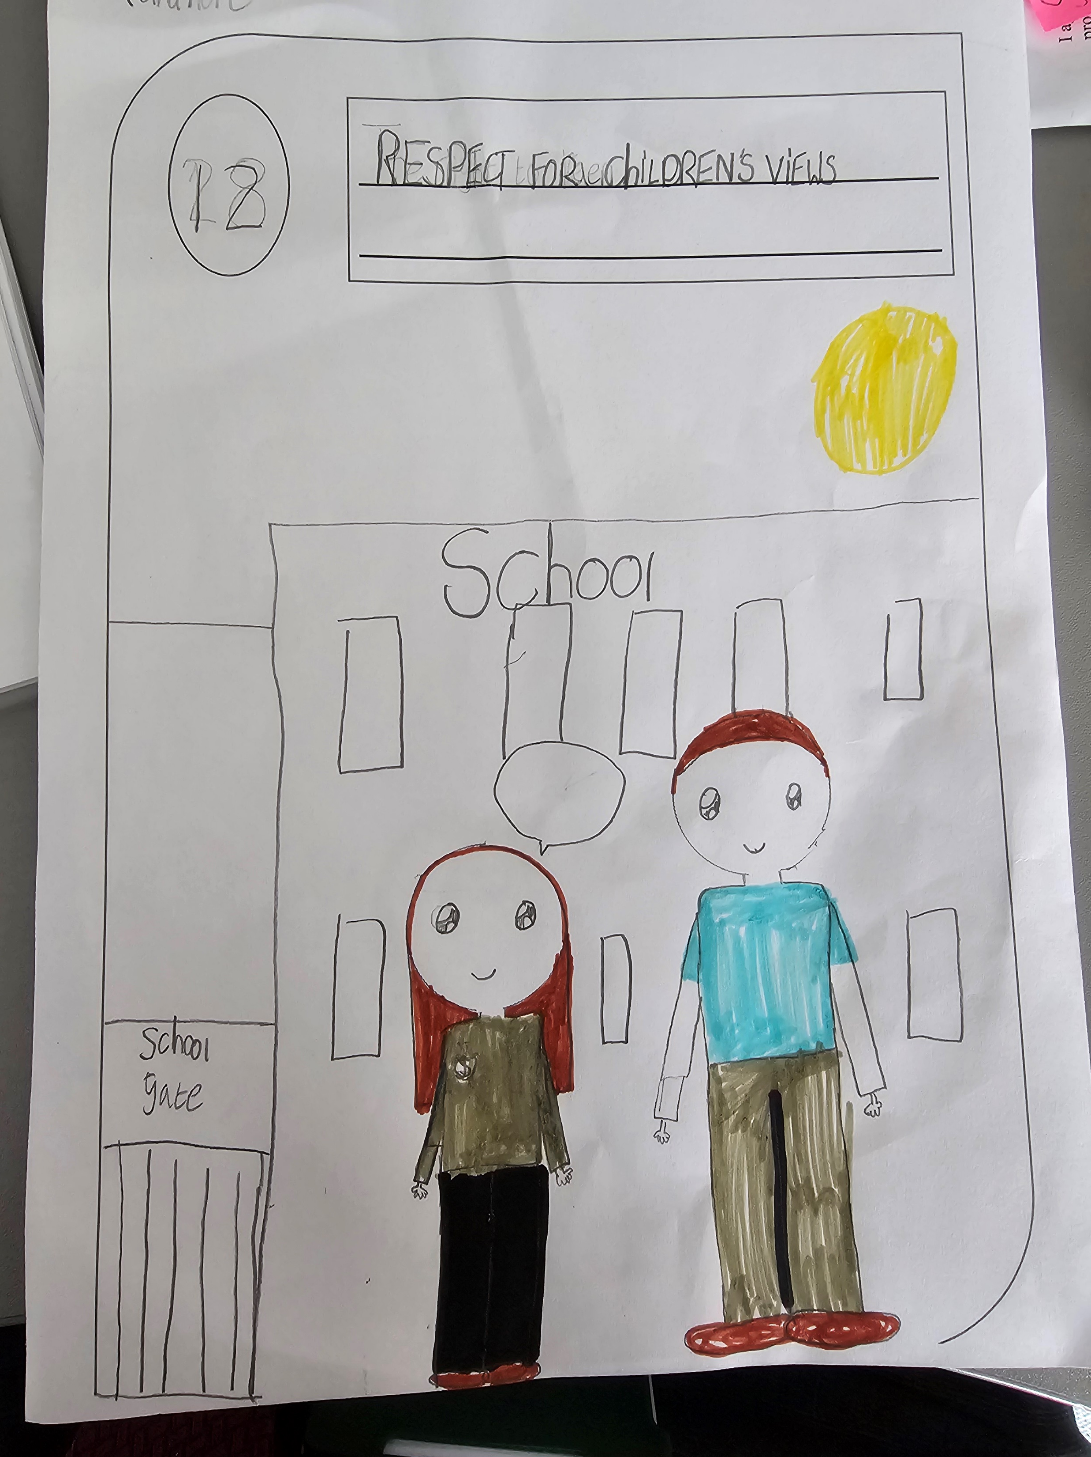
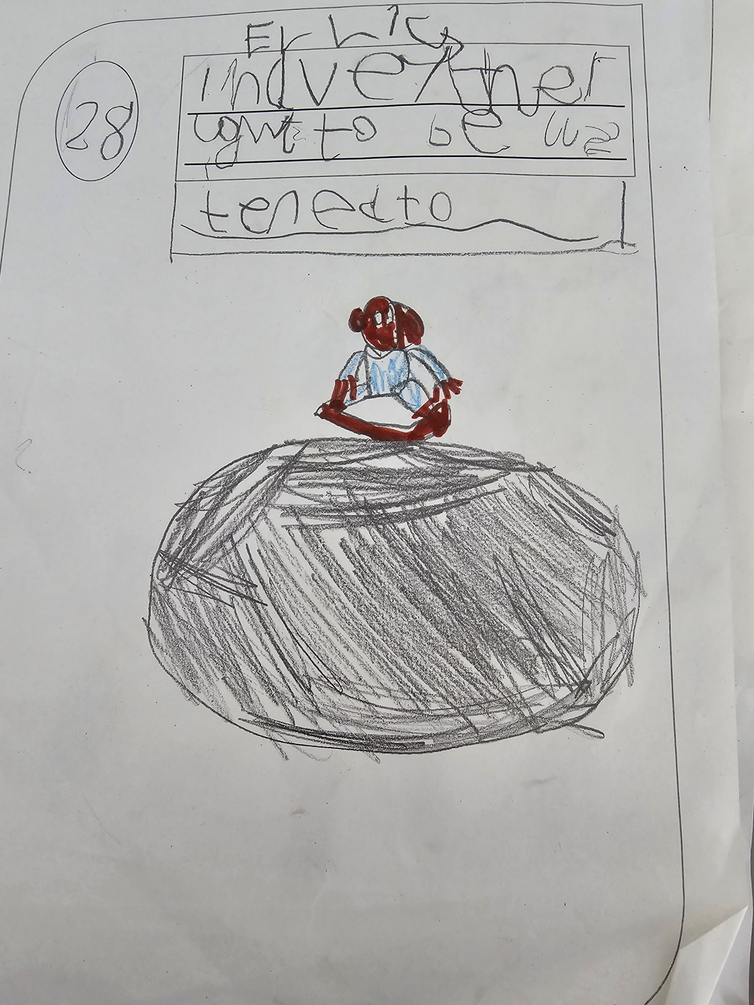
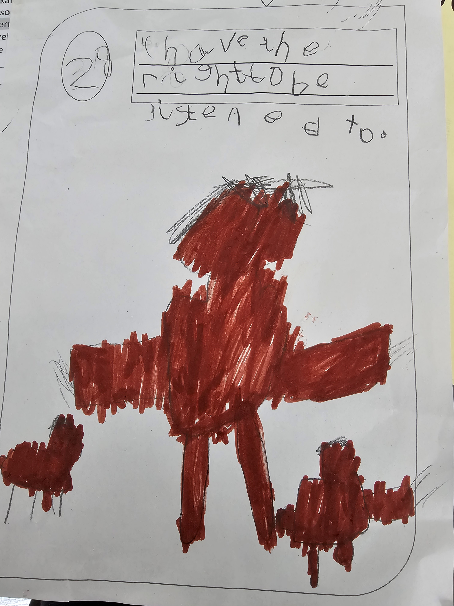
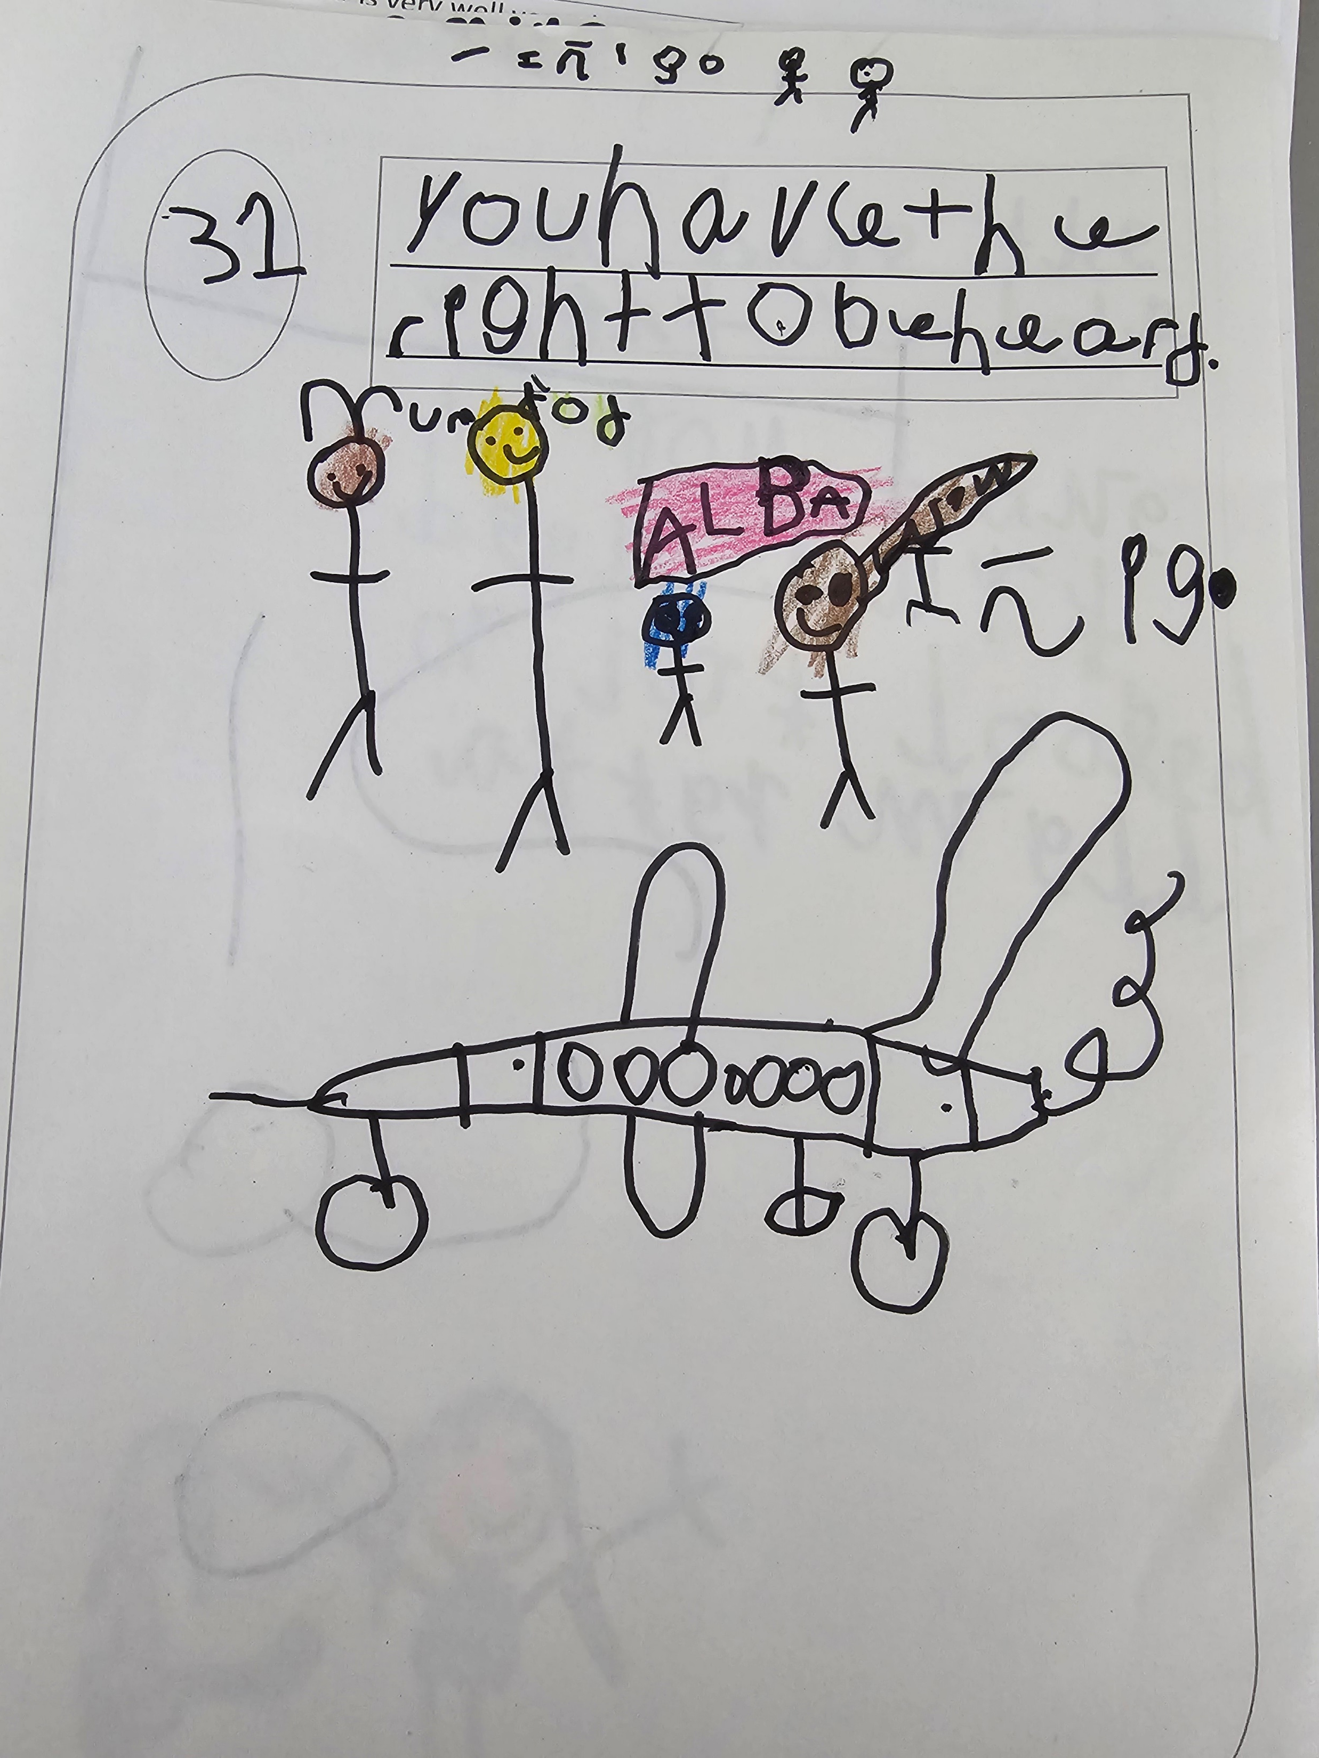
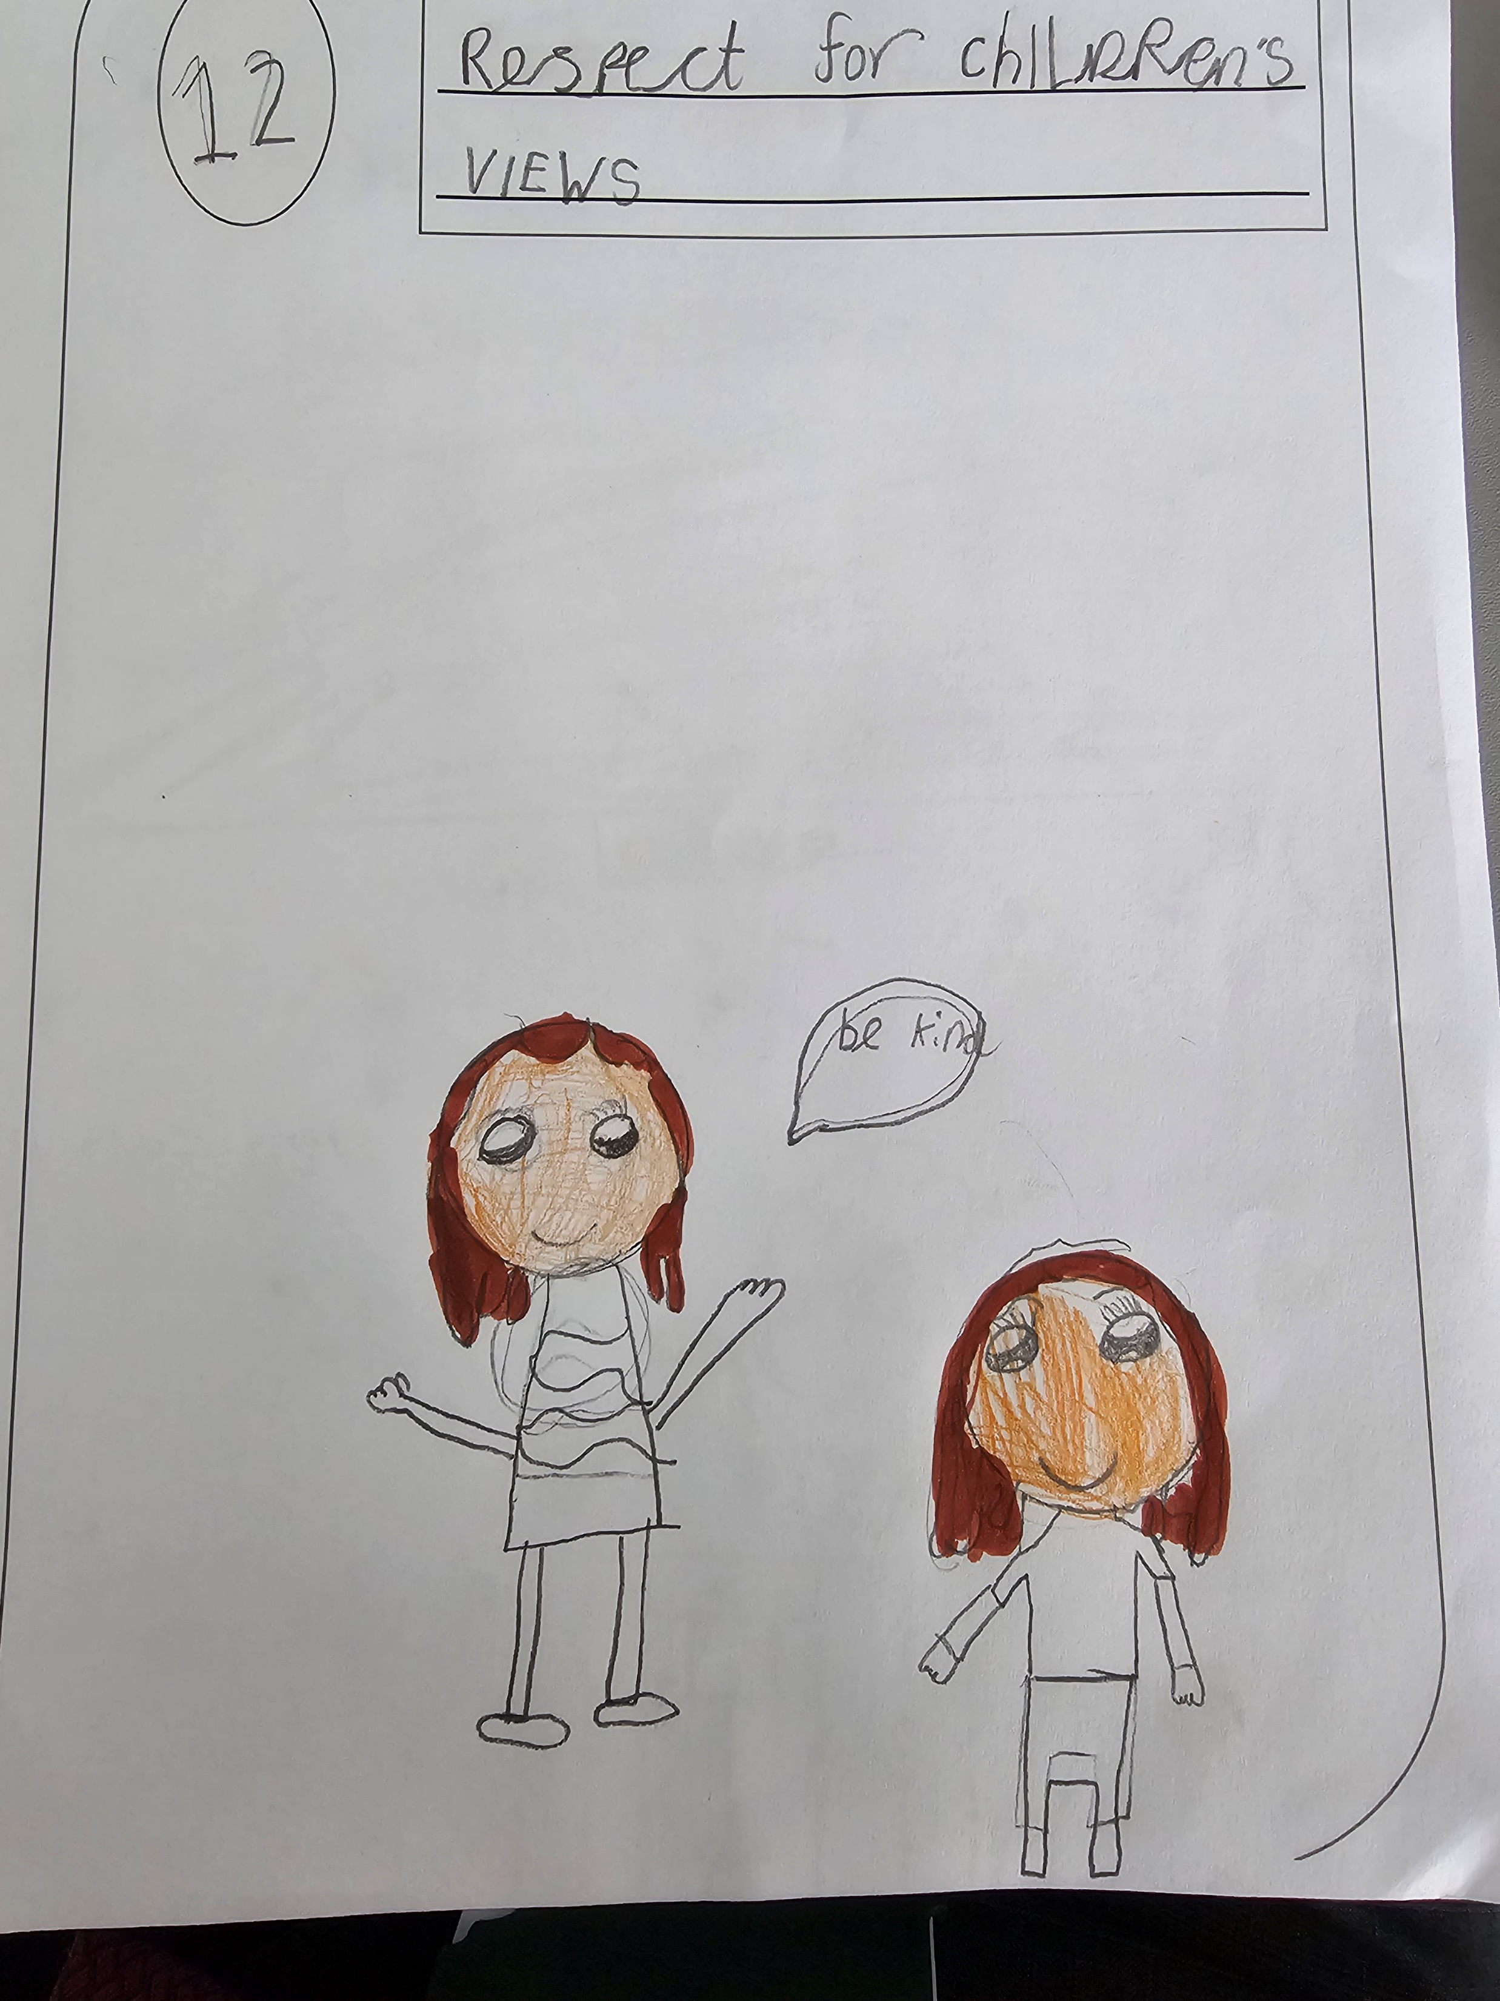
Article 12
The Right to have my views heard

Slide 5
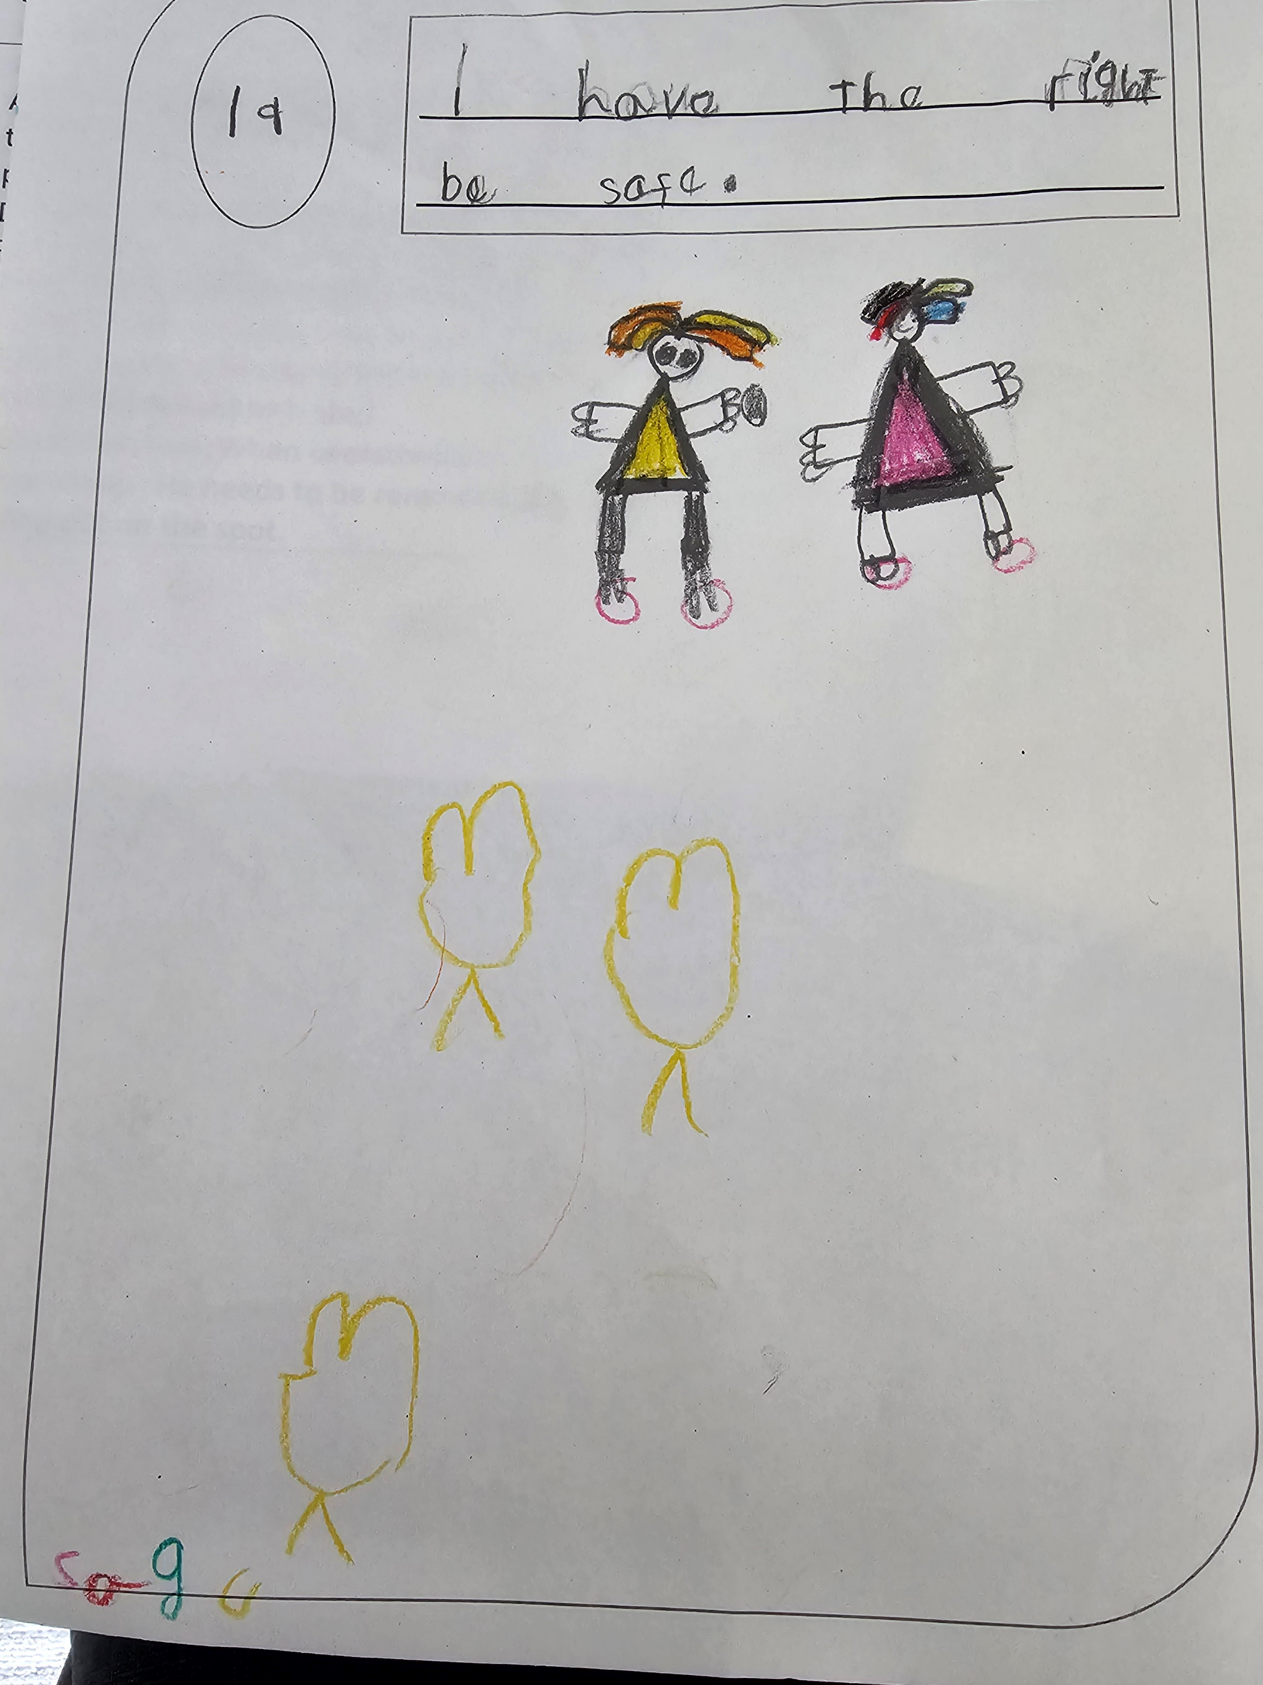
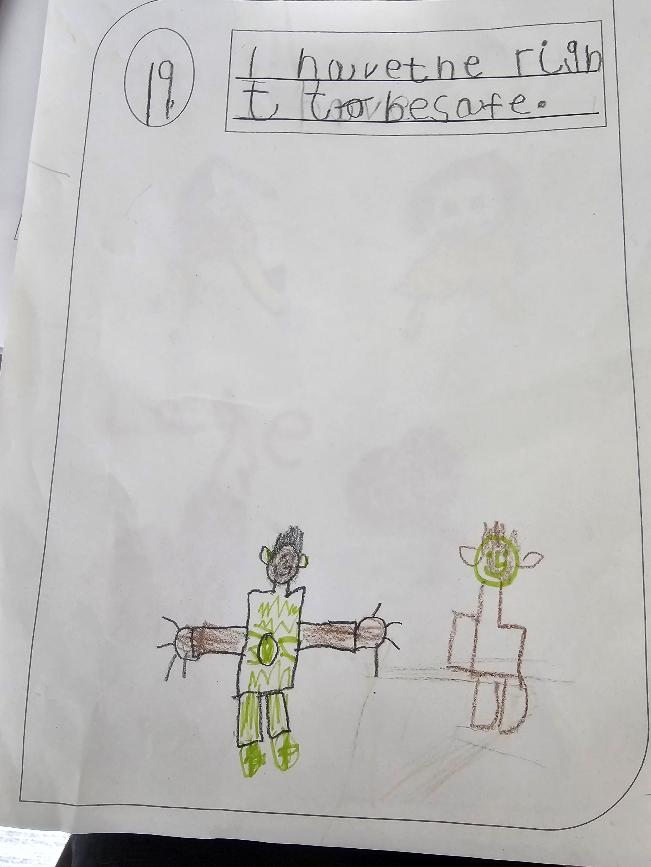
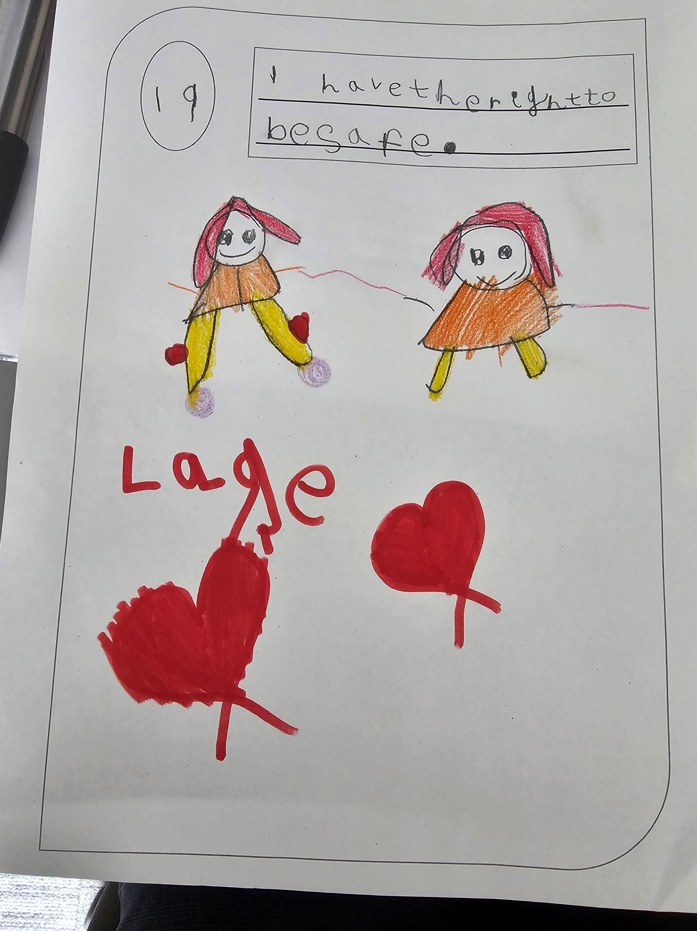
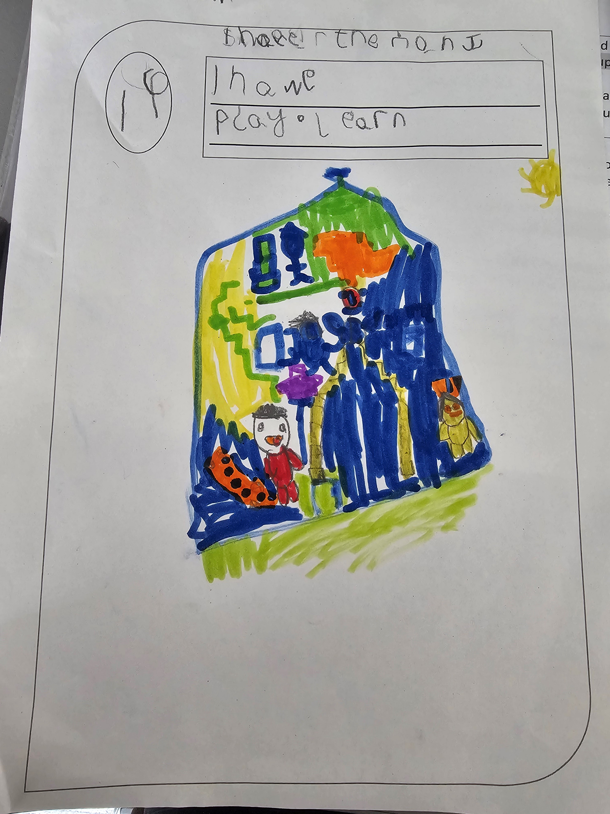
Article 19
The Right to be protected from harm

Slide 6
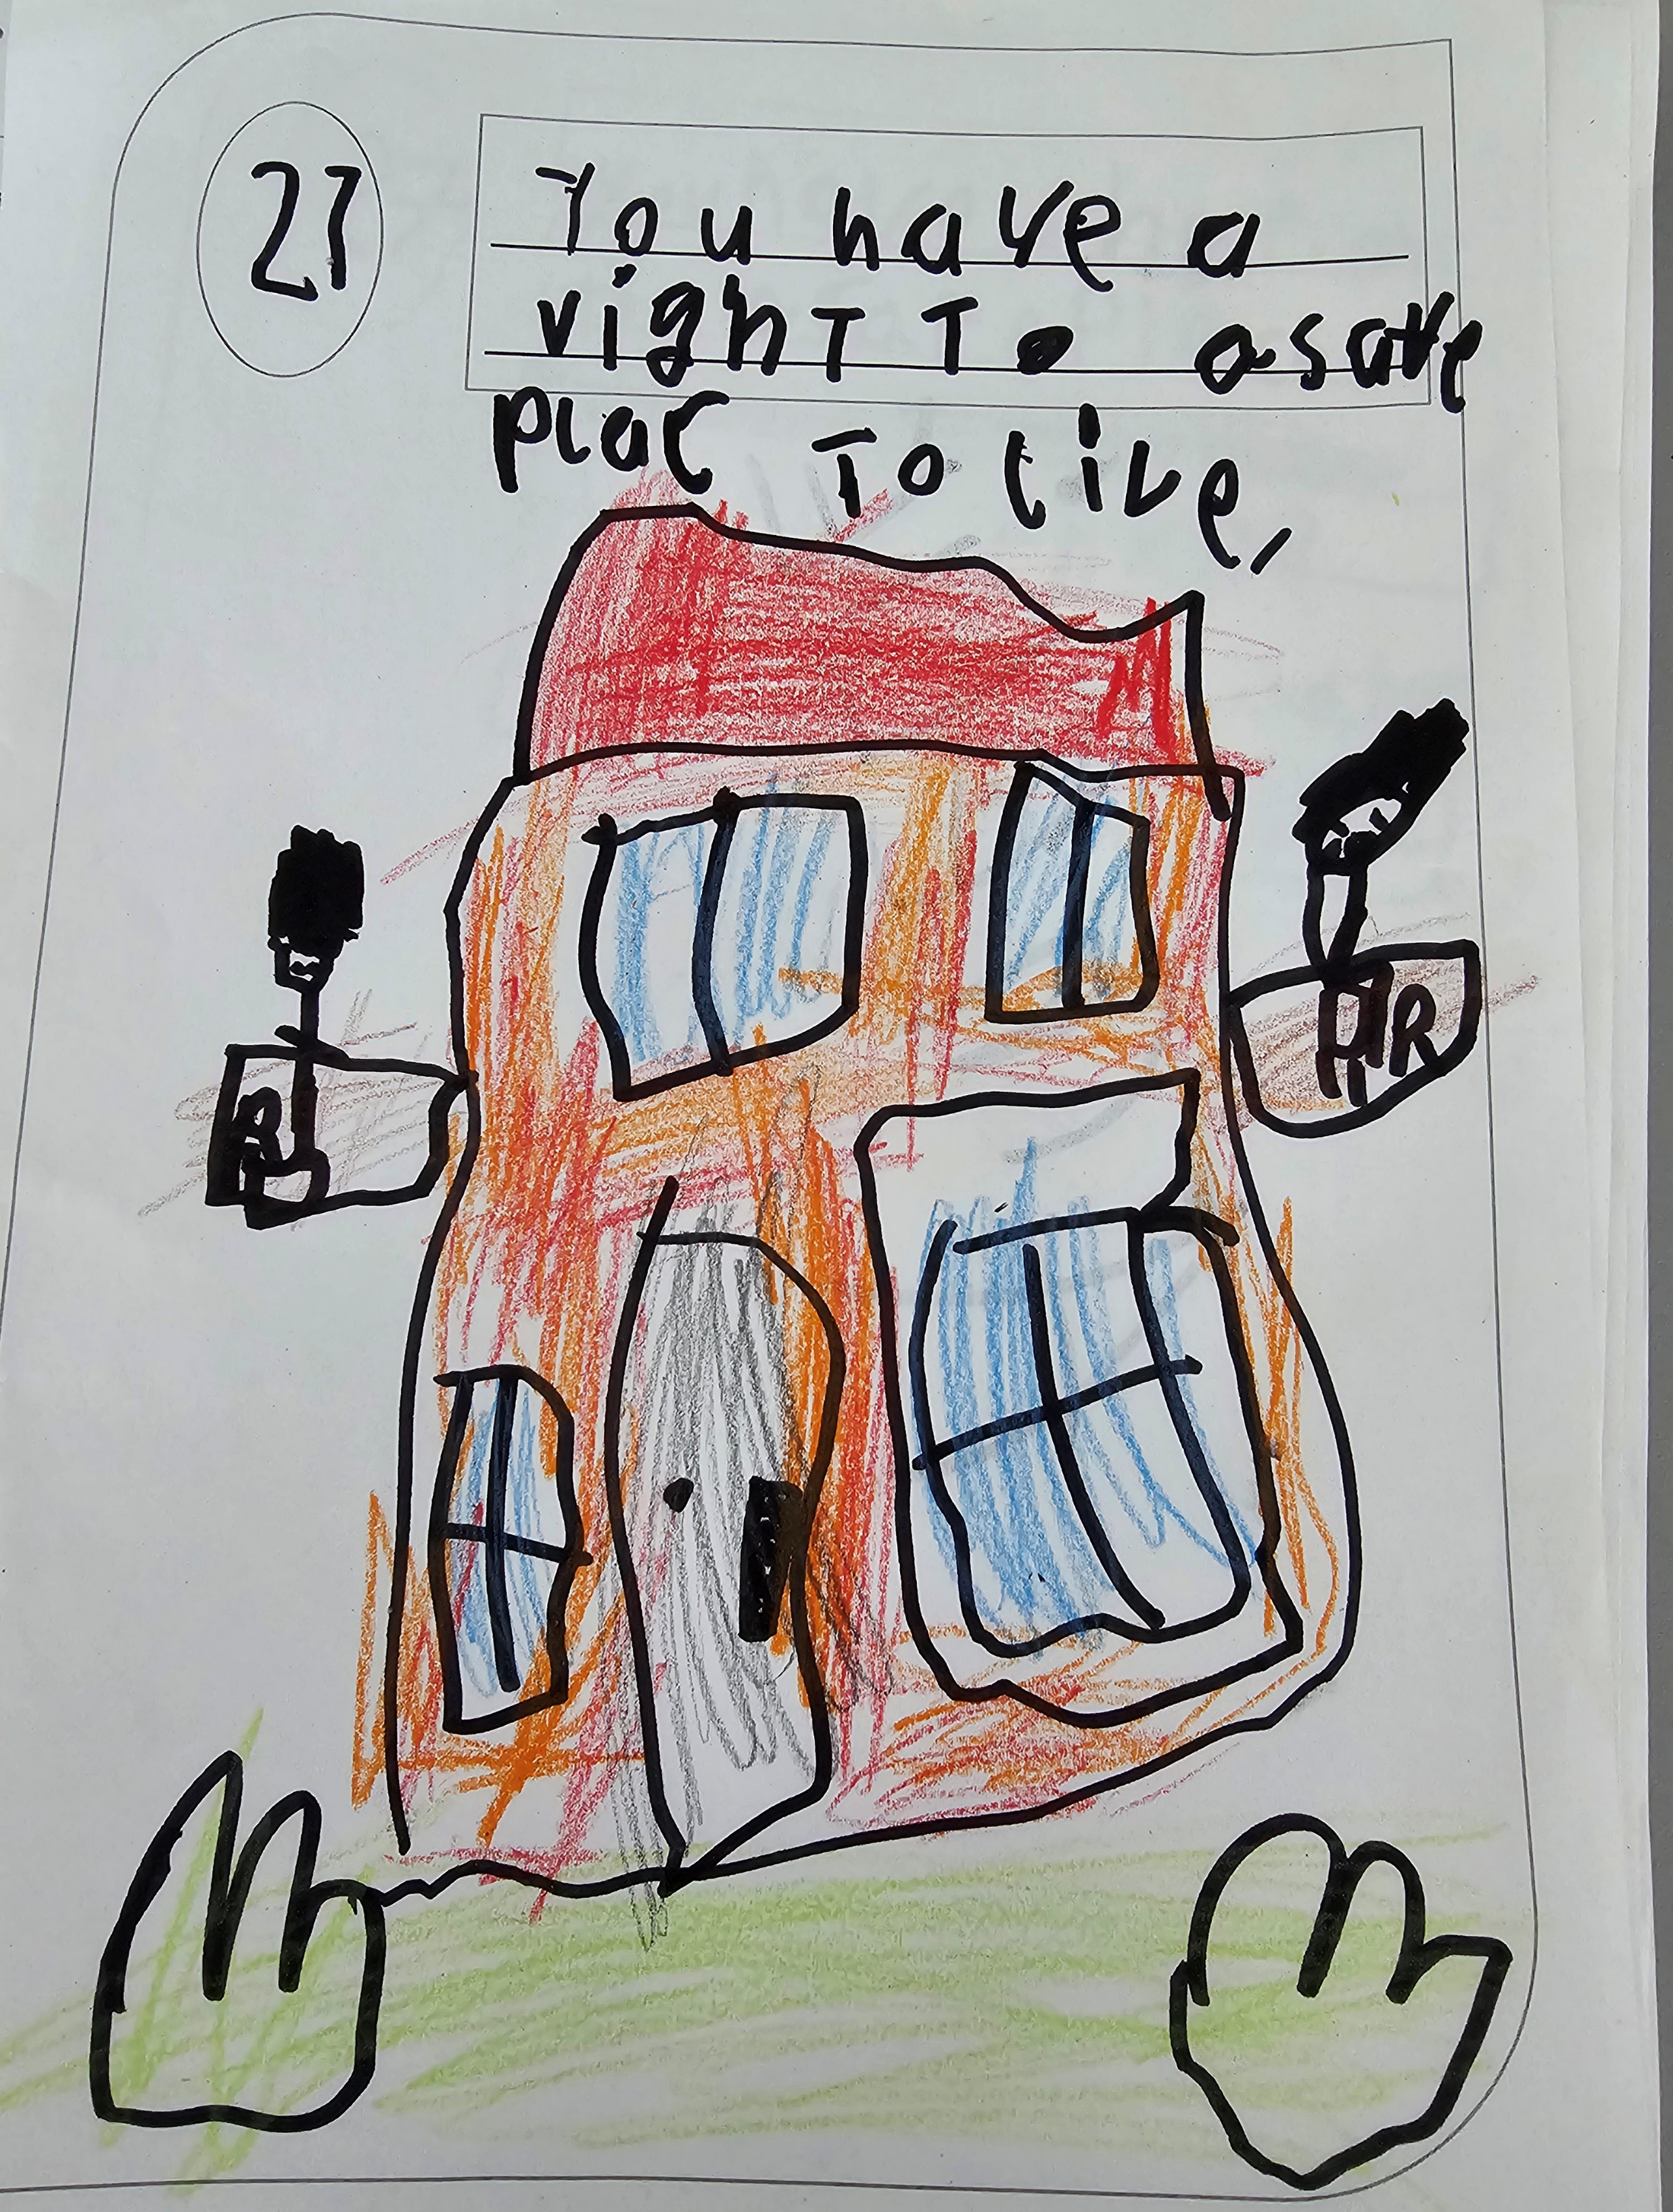
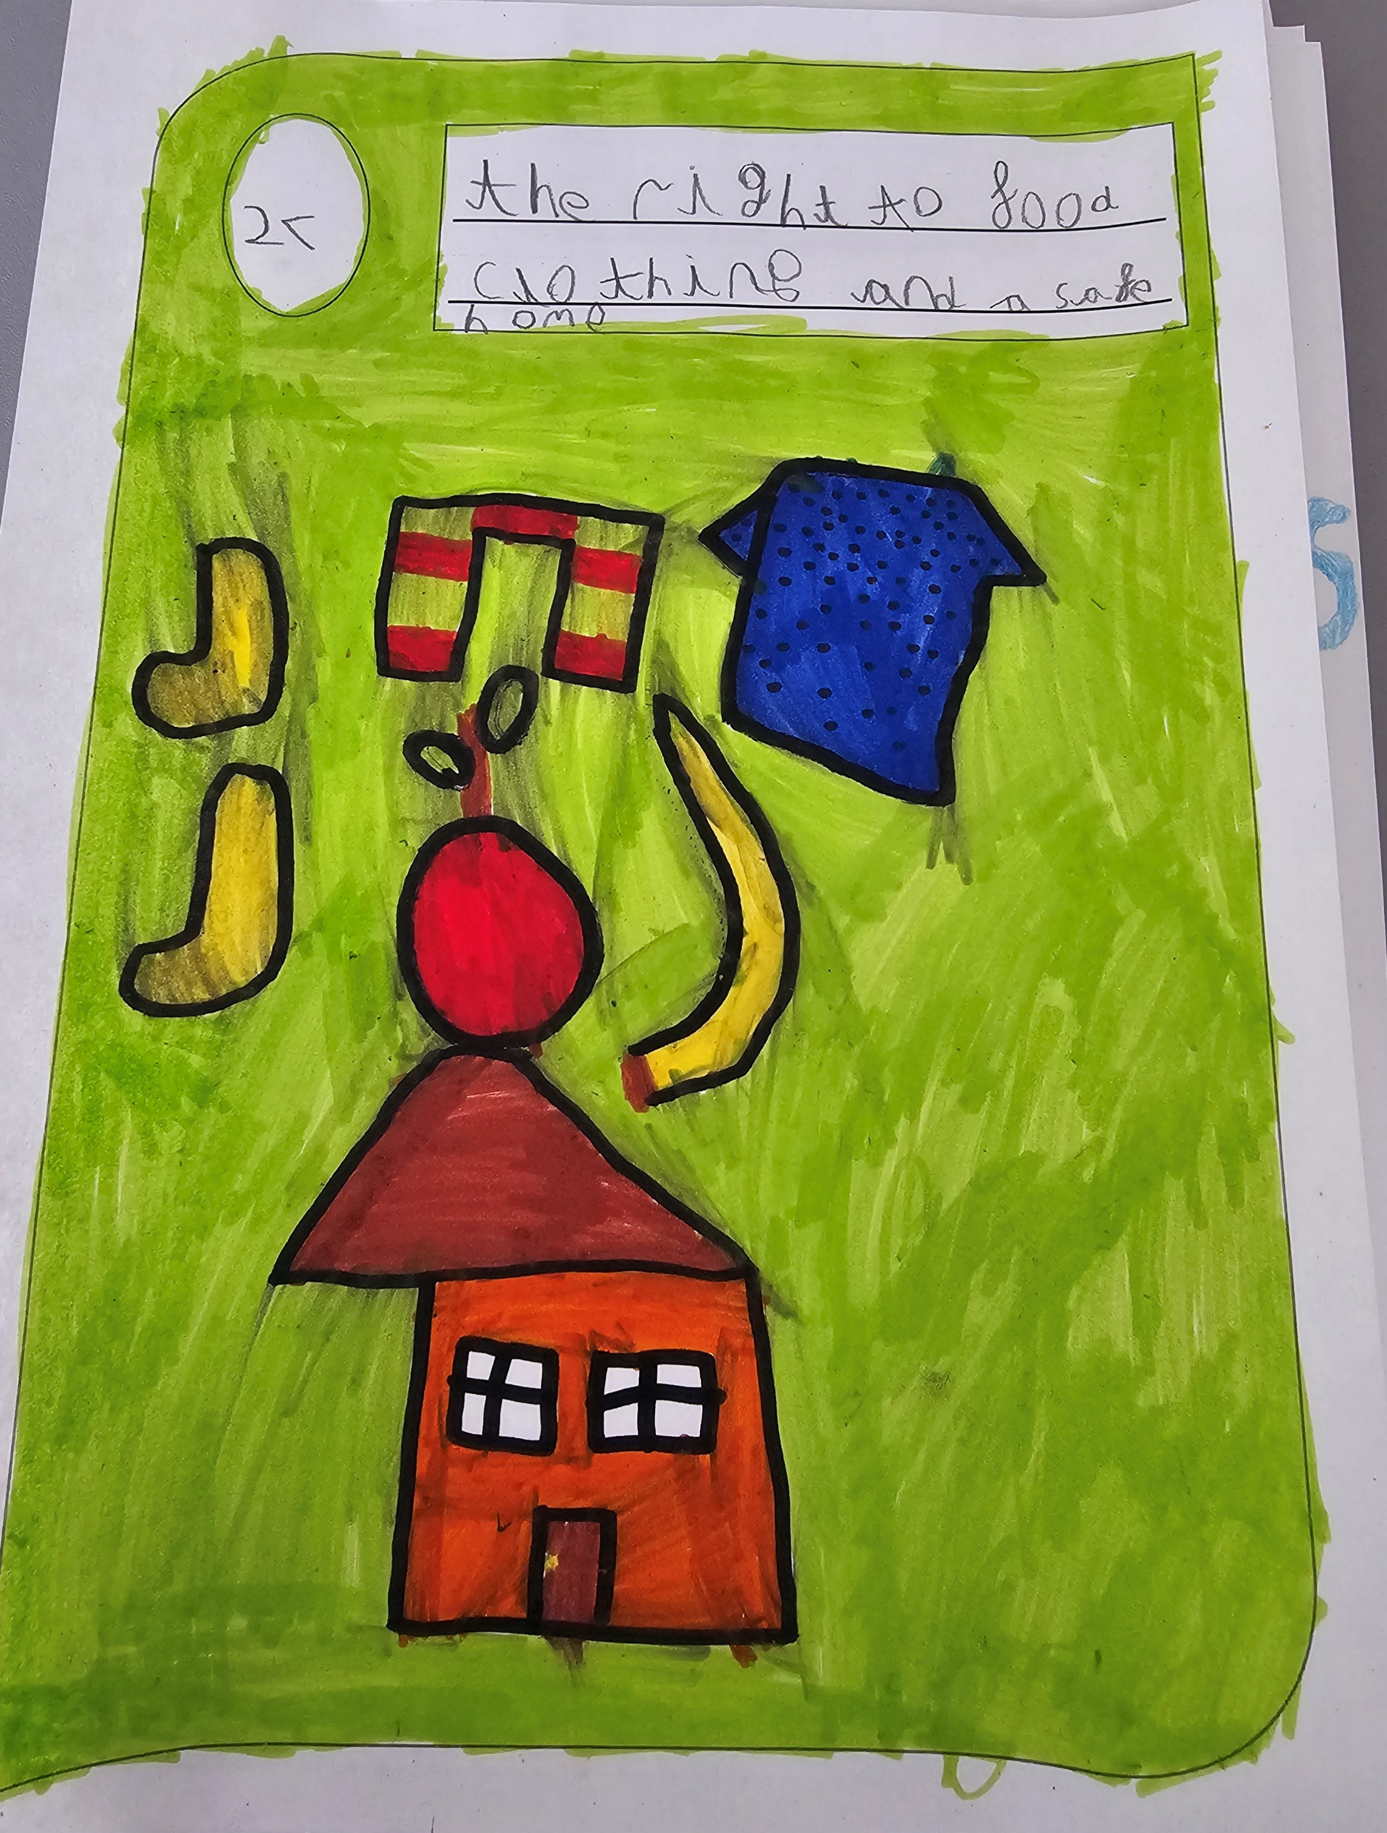
Article 27
The right to food, clothes and a clean safe home

Slide 7
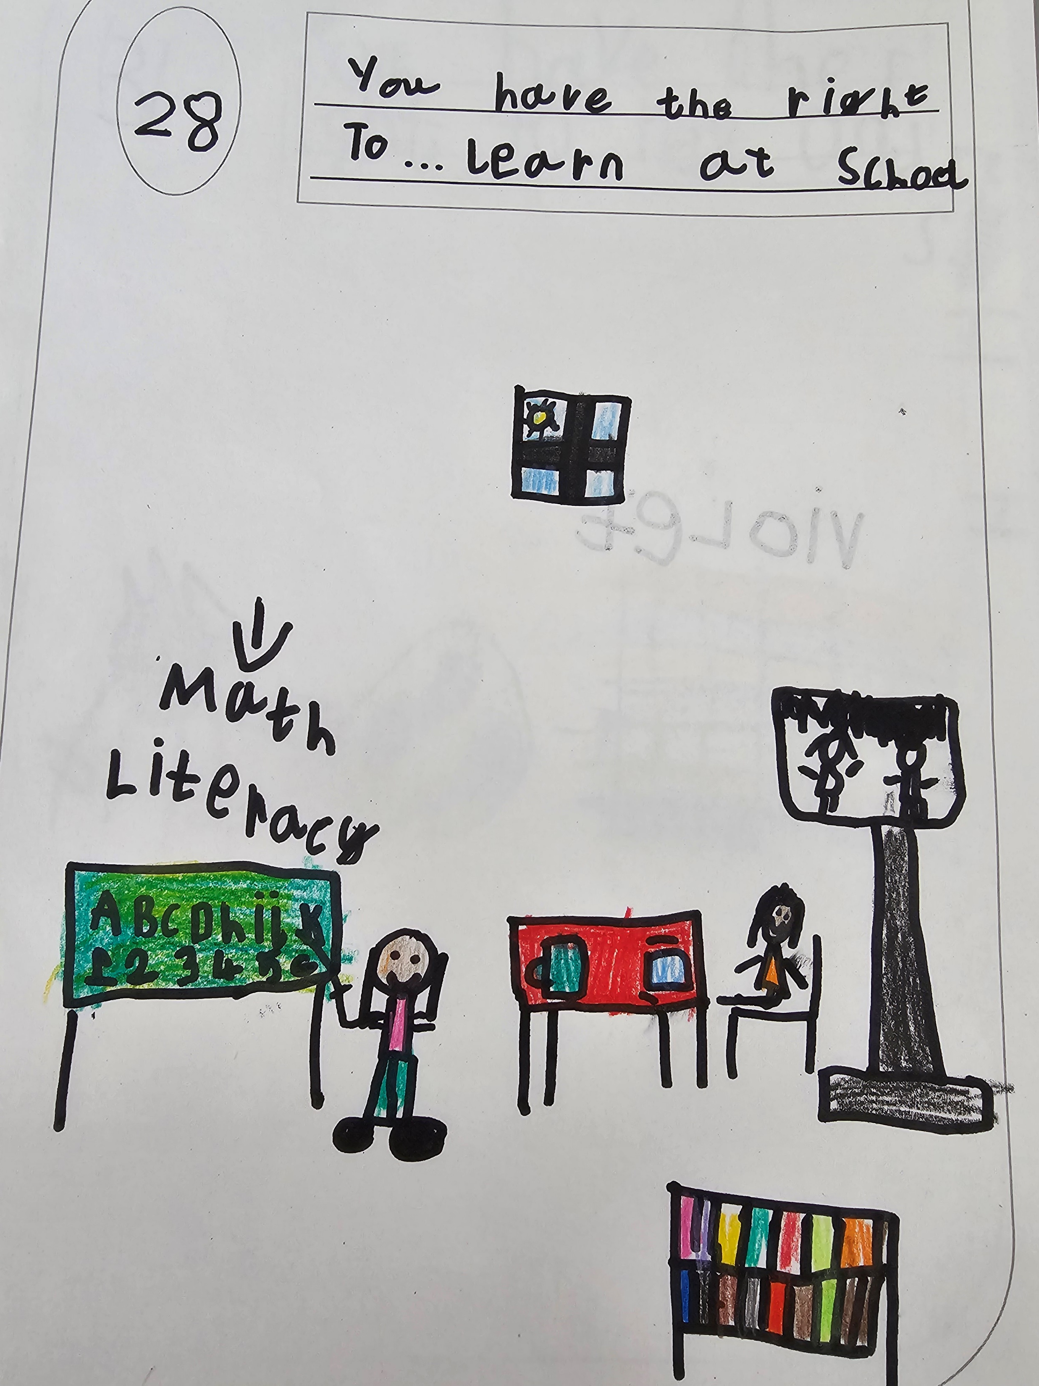
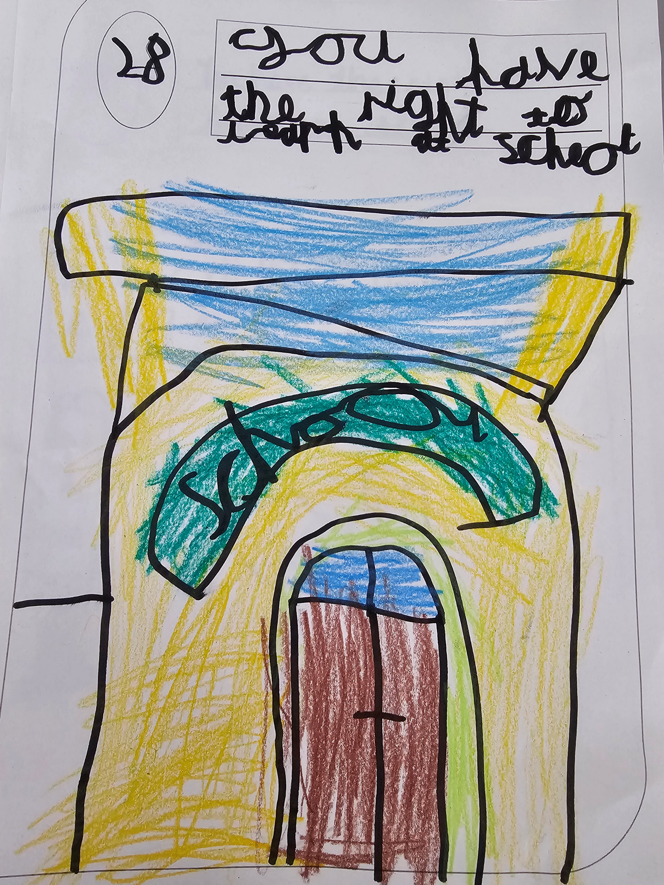
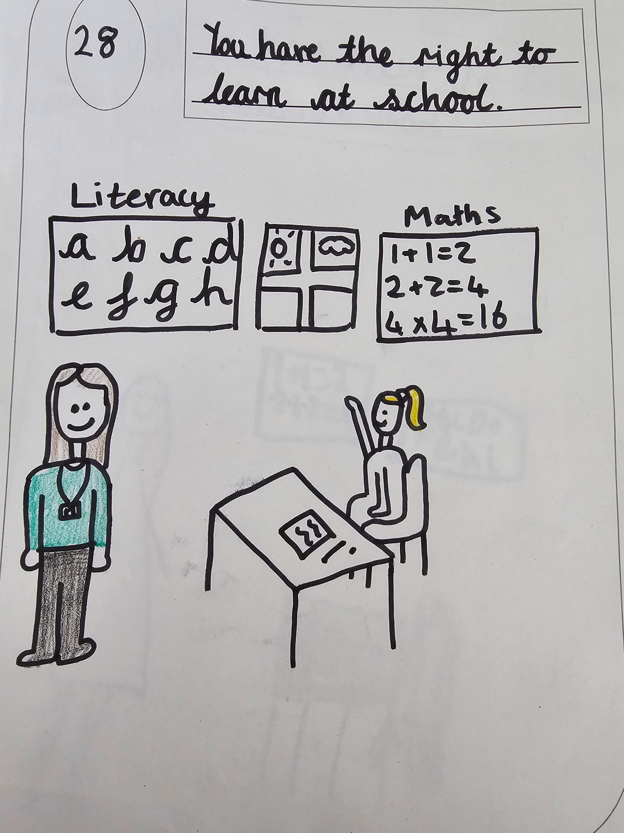
Article 28 The Right to Learn in School

Slide 8
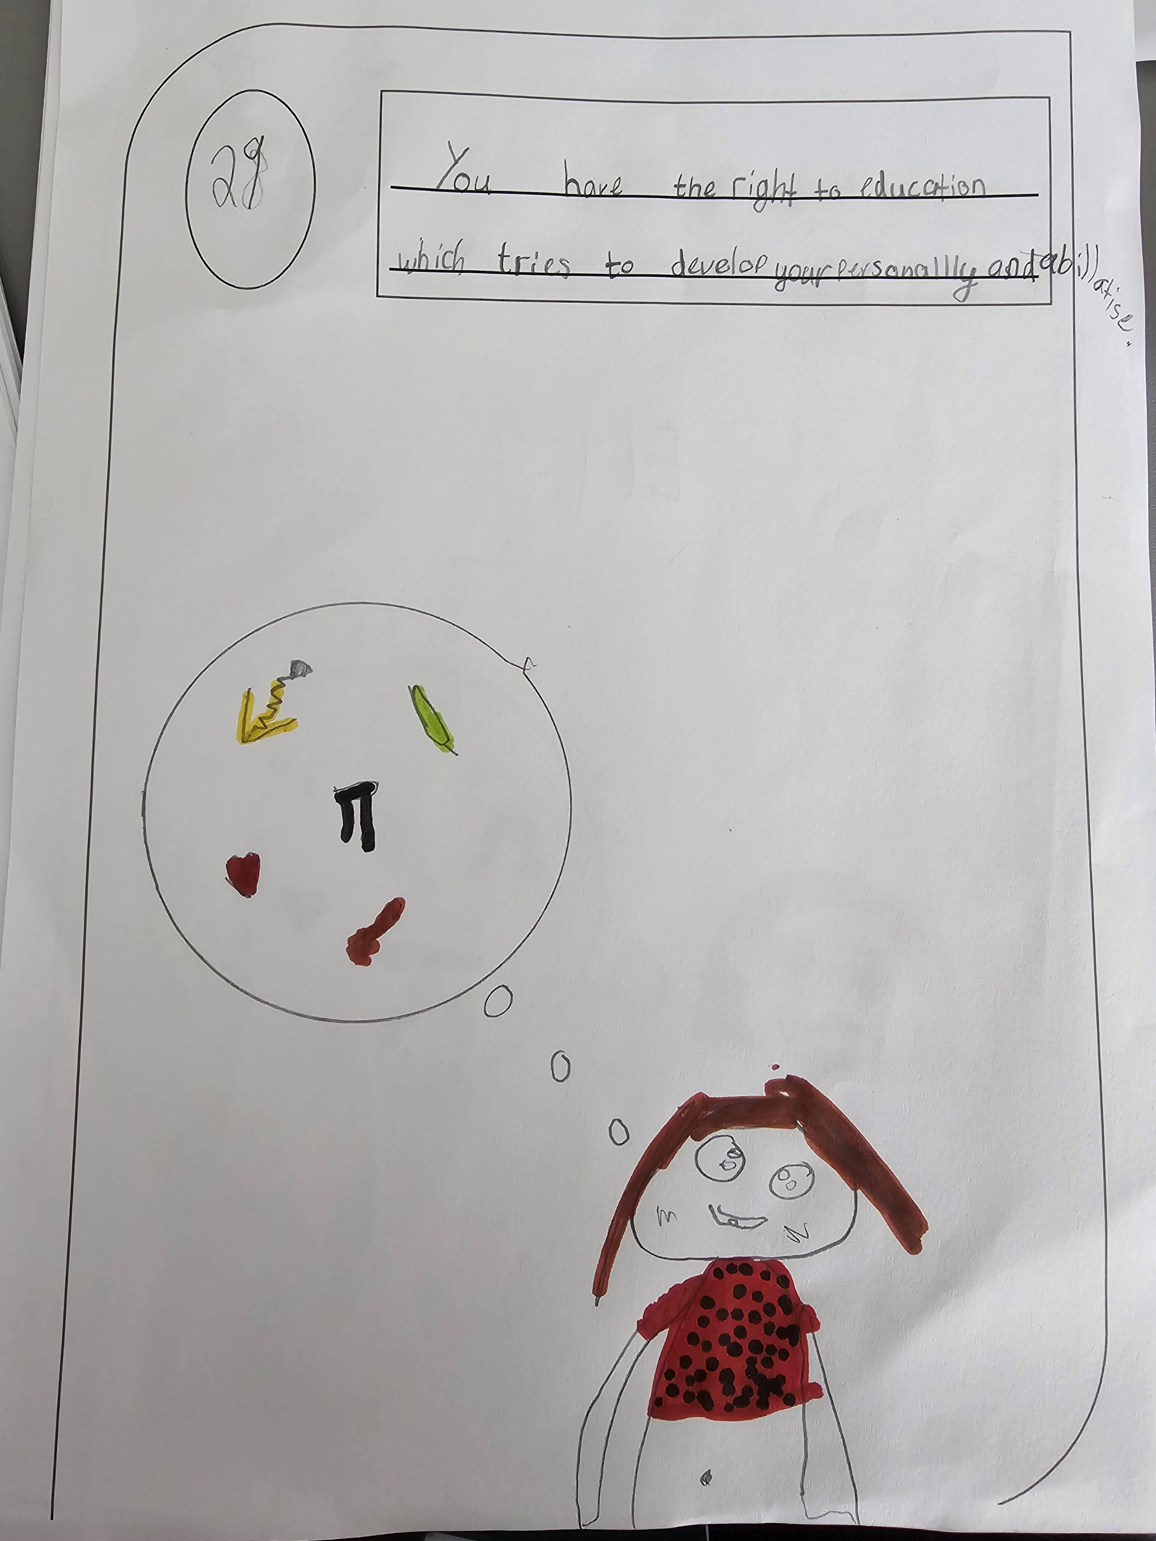
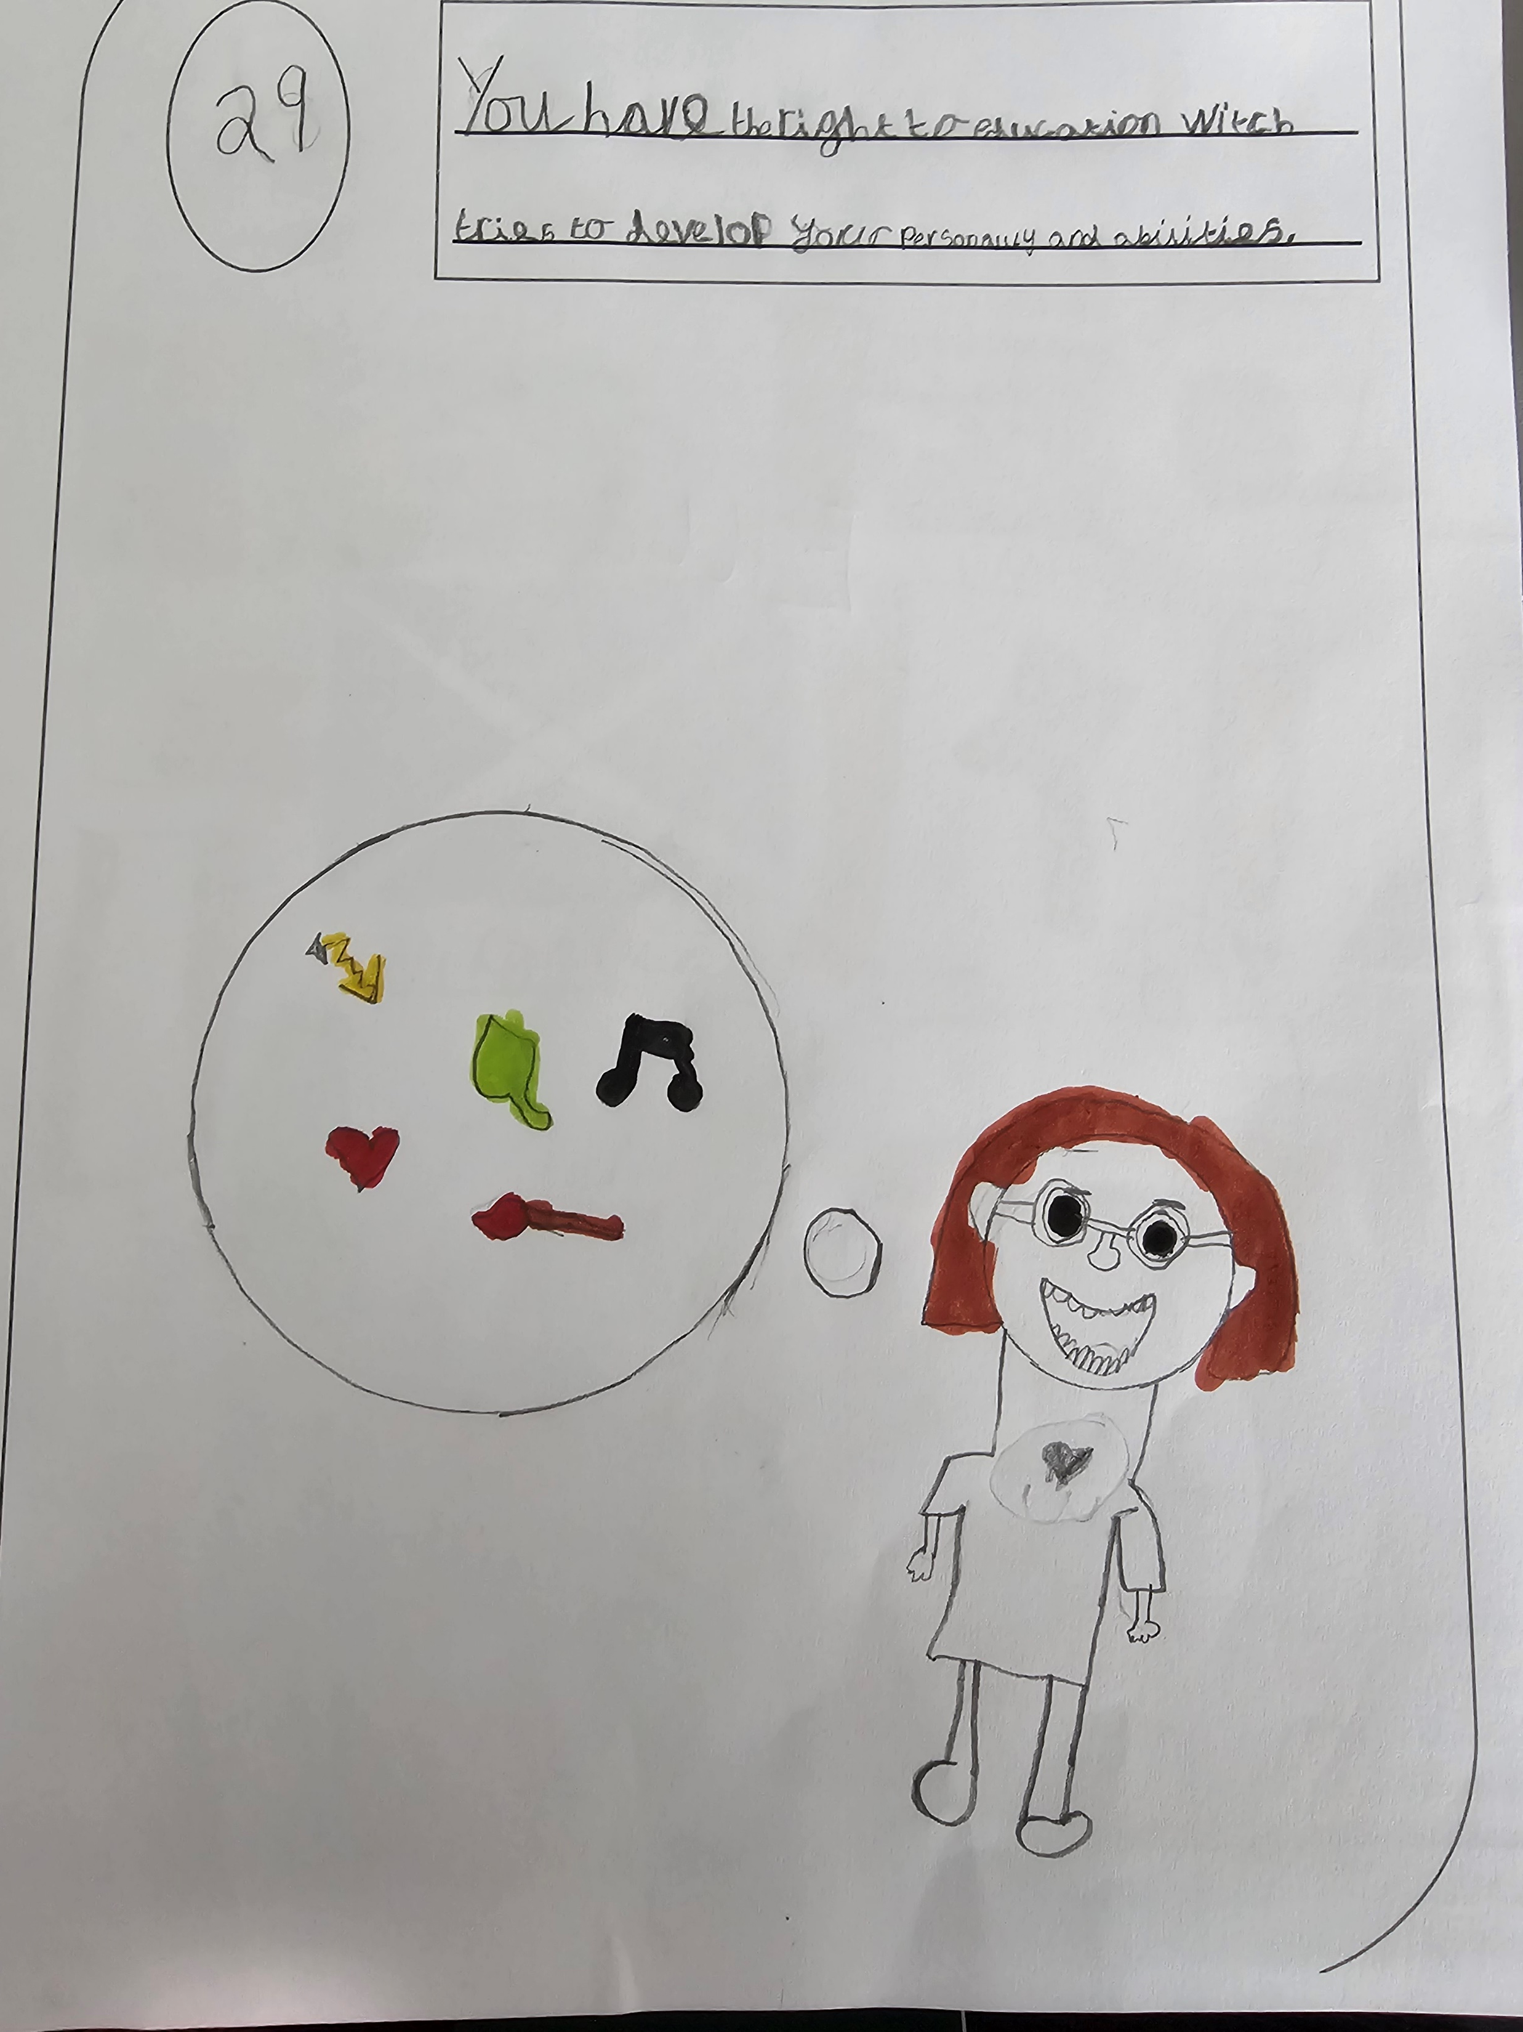
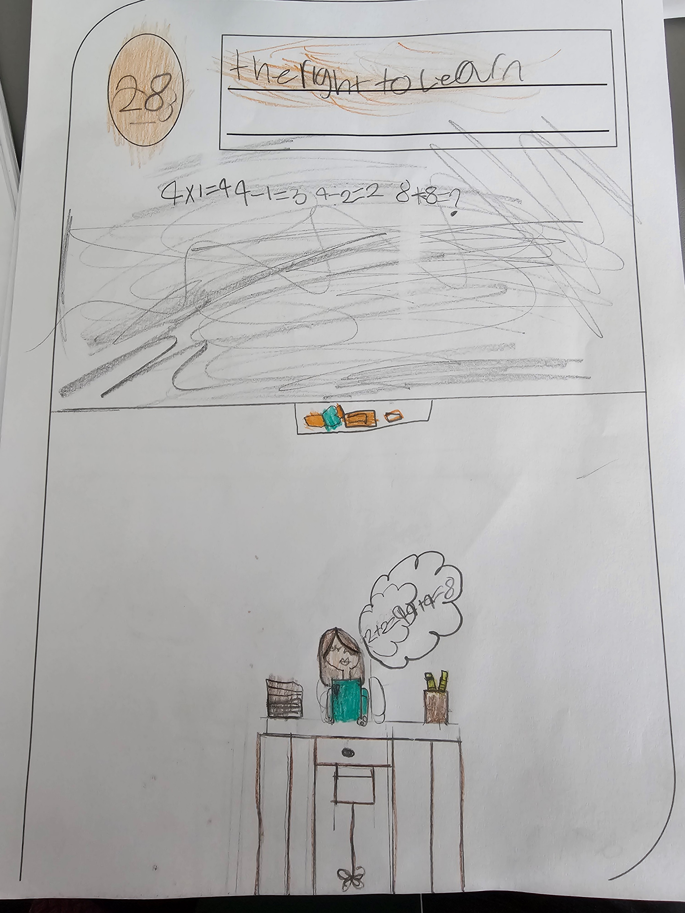

Slide 9
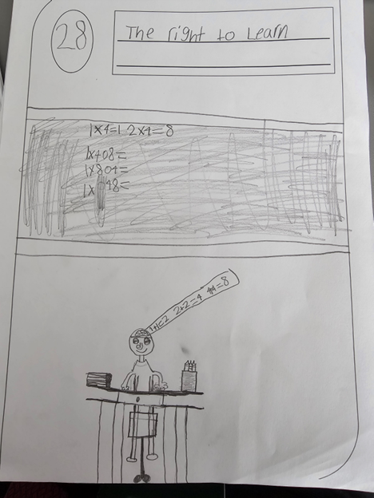
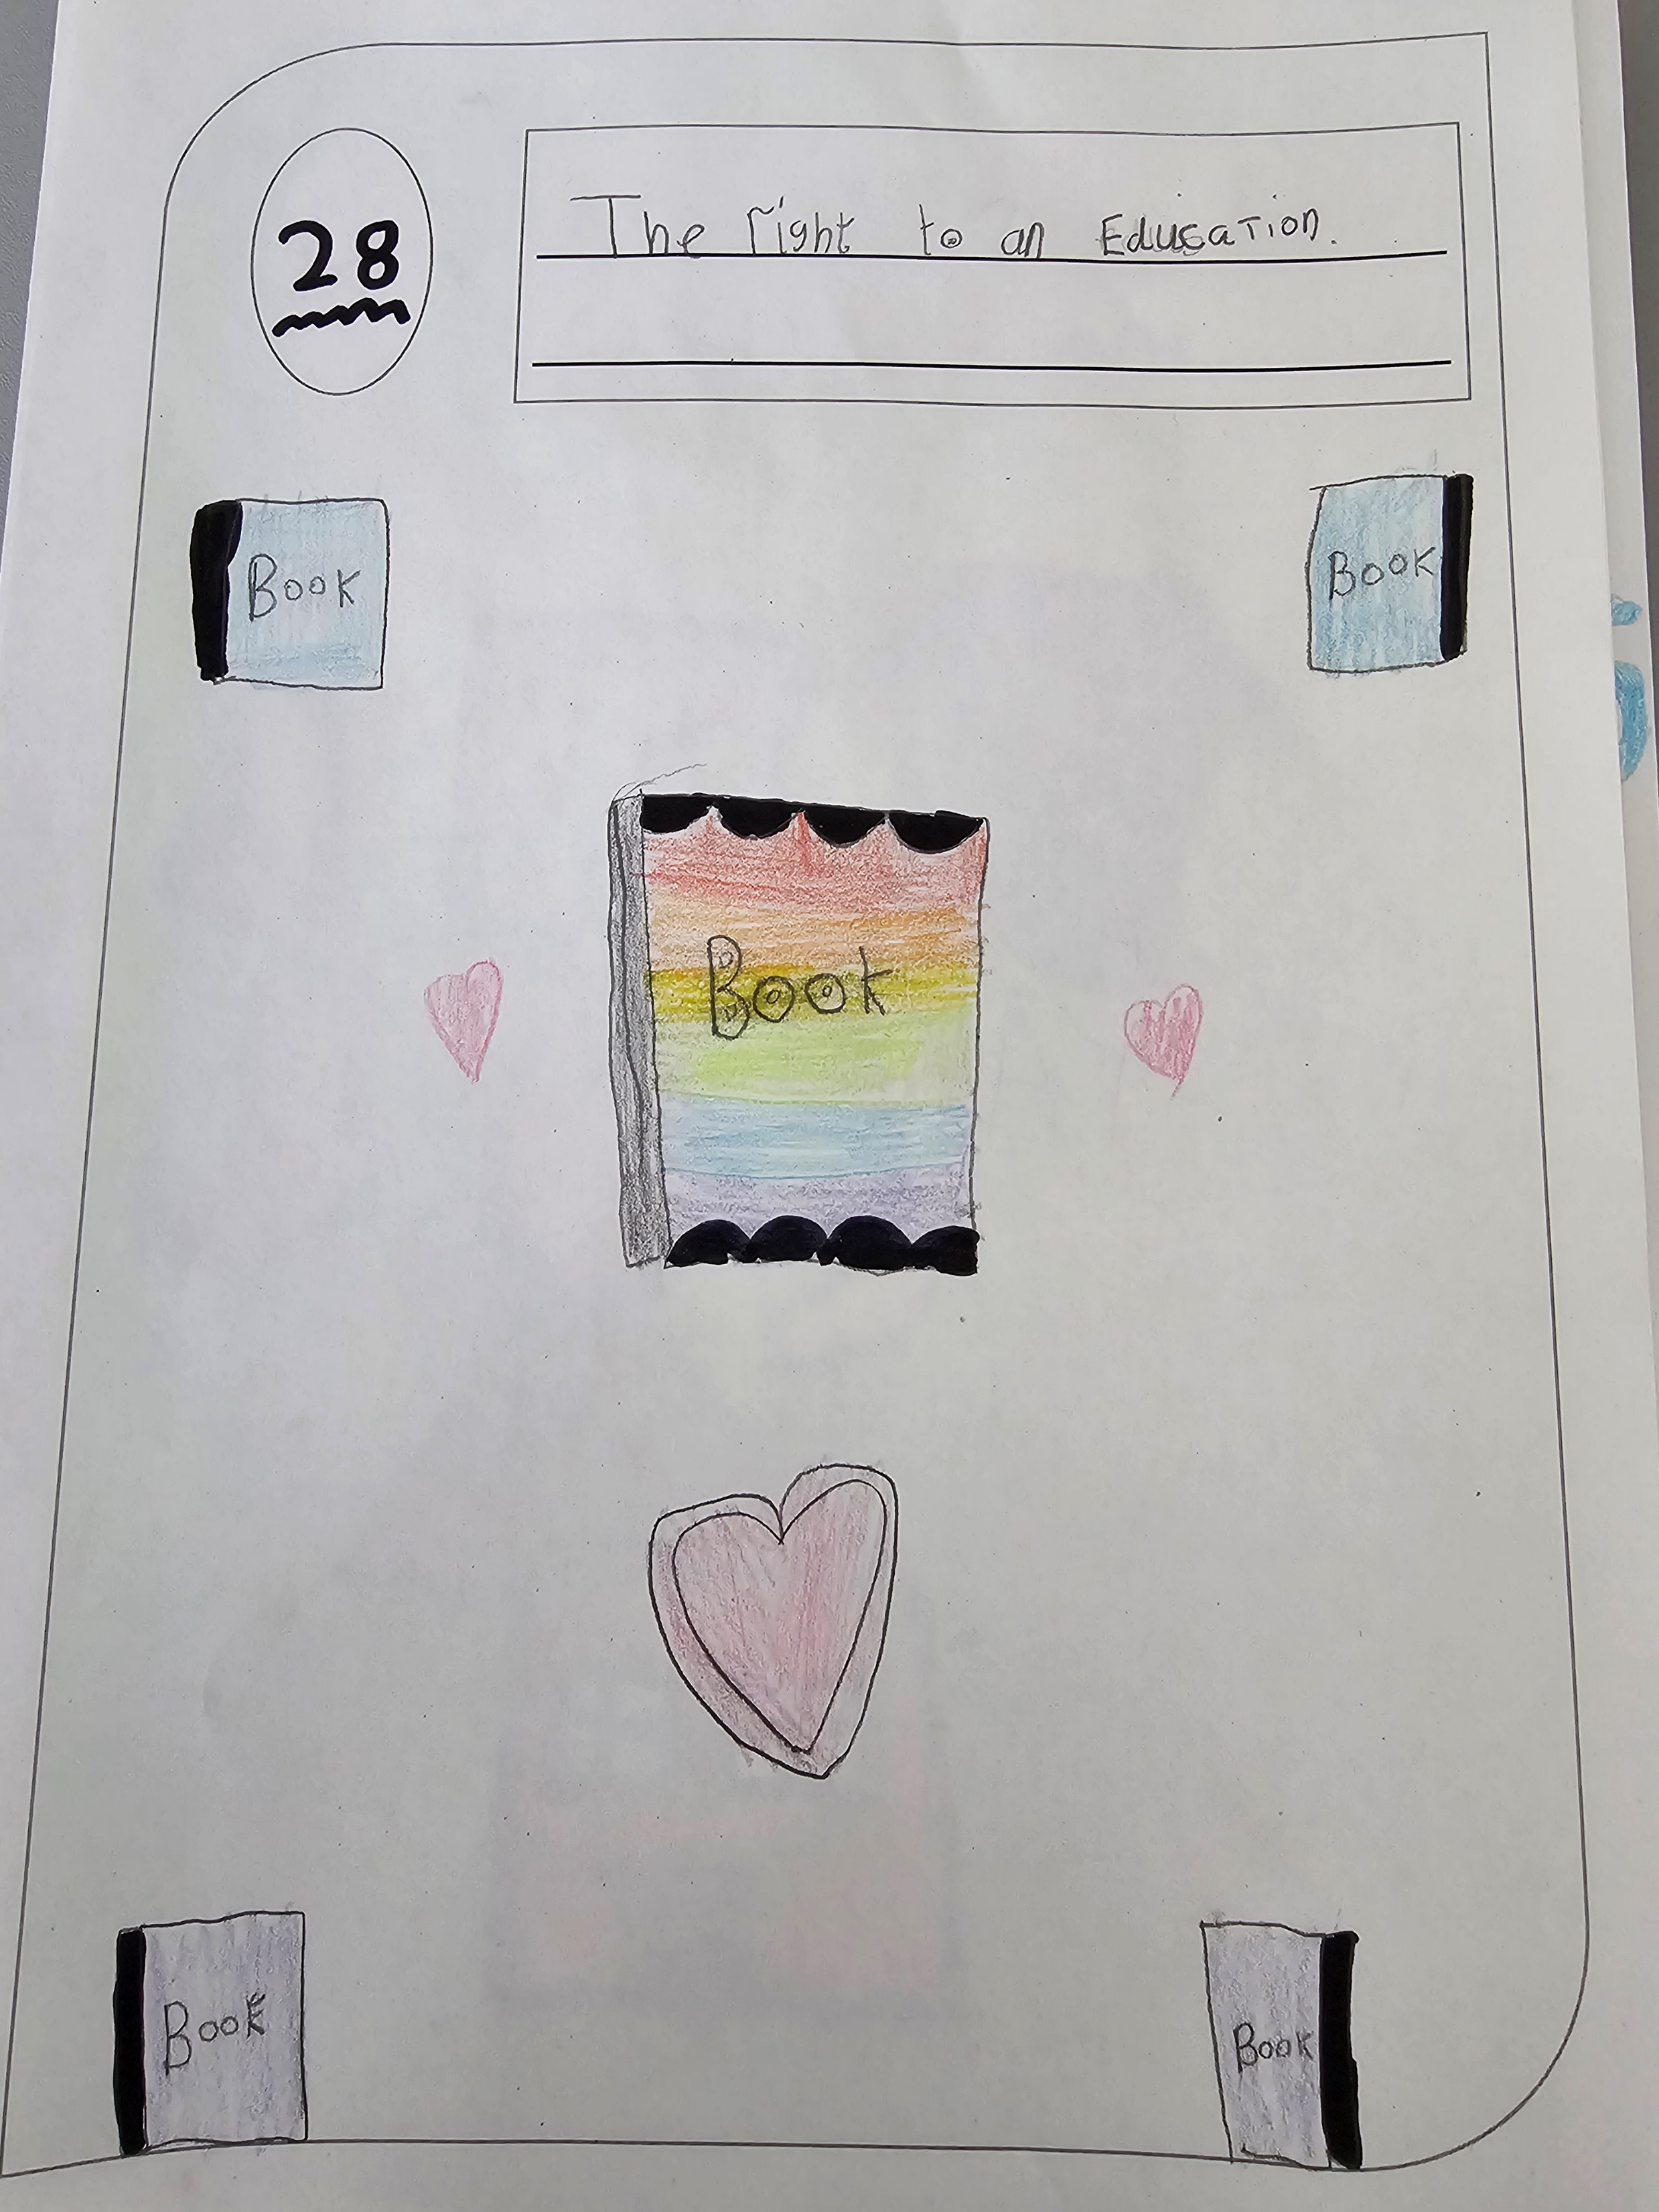

Slide 10
Article 30
The Right to learn about my culture and language

Slide 11
Article 31
The Right to relax and play

Slide 13
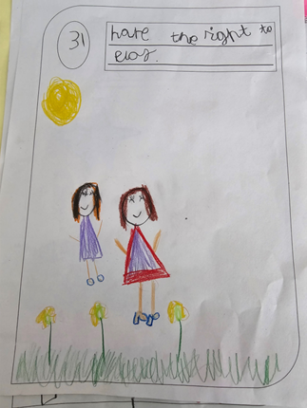

Slide 14
Article 39
The Right to extra help if I have been hurt or badly treated

Slide 15
St John’s RRSA Logo designs
Pupils and staff will choose their favourite design and this will be adopted as our RRSA logo

Slide 16
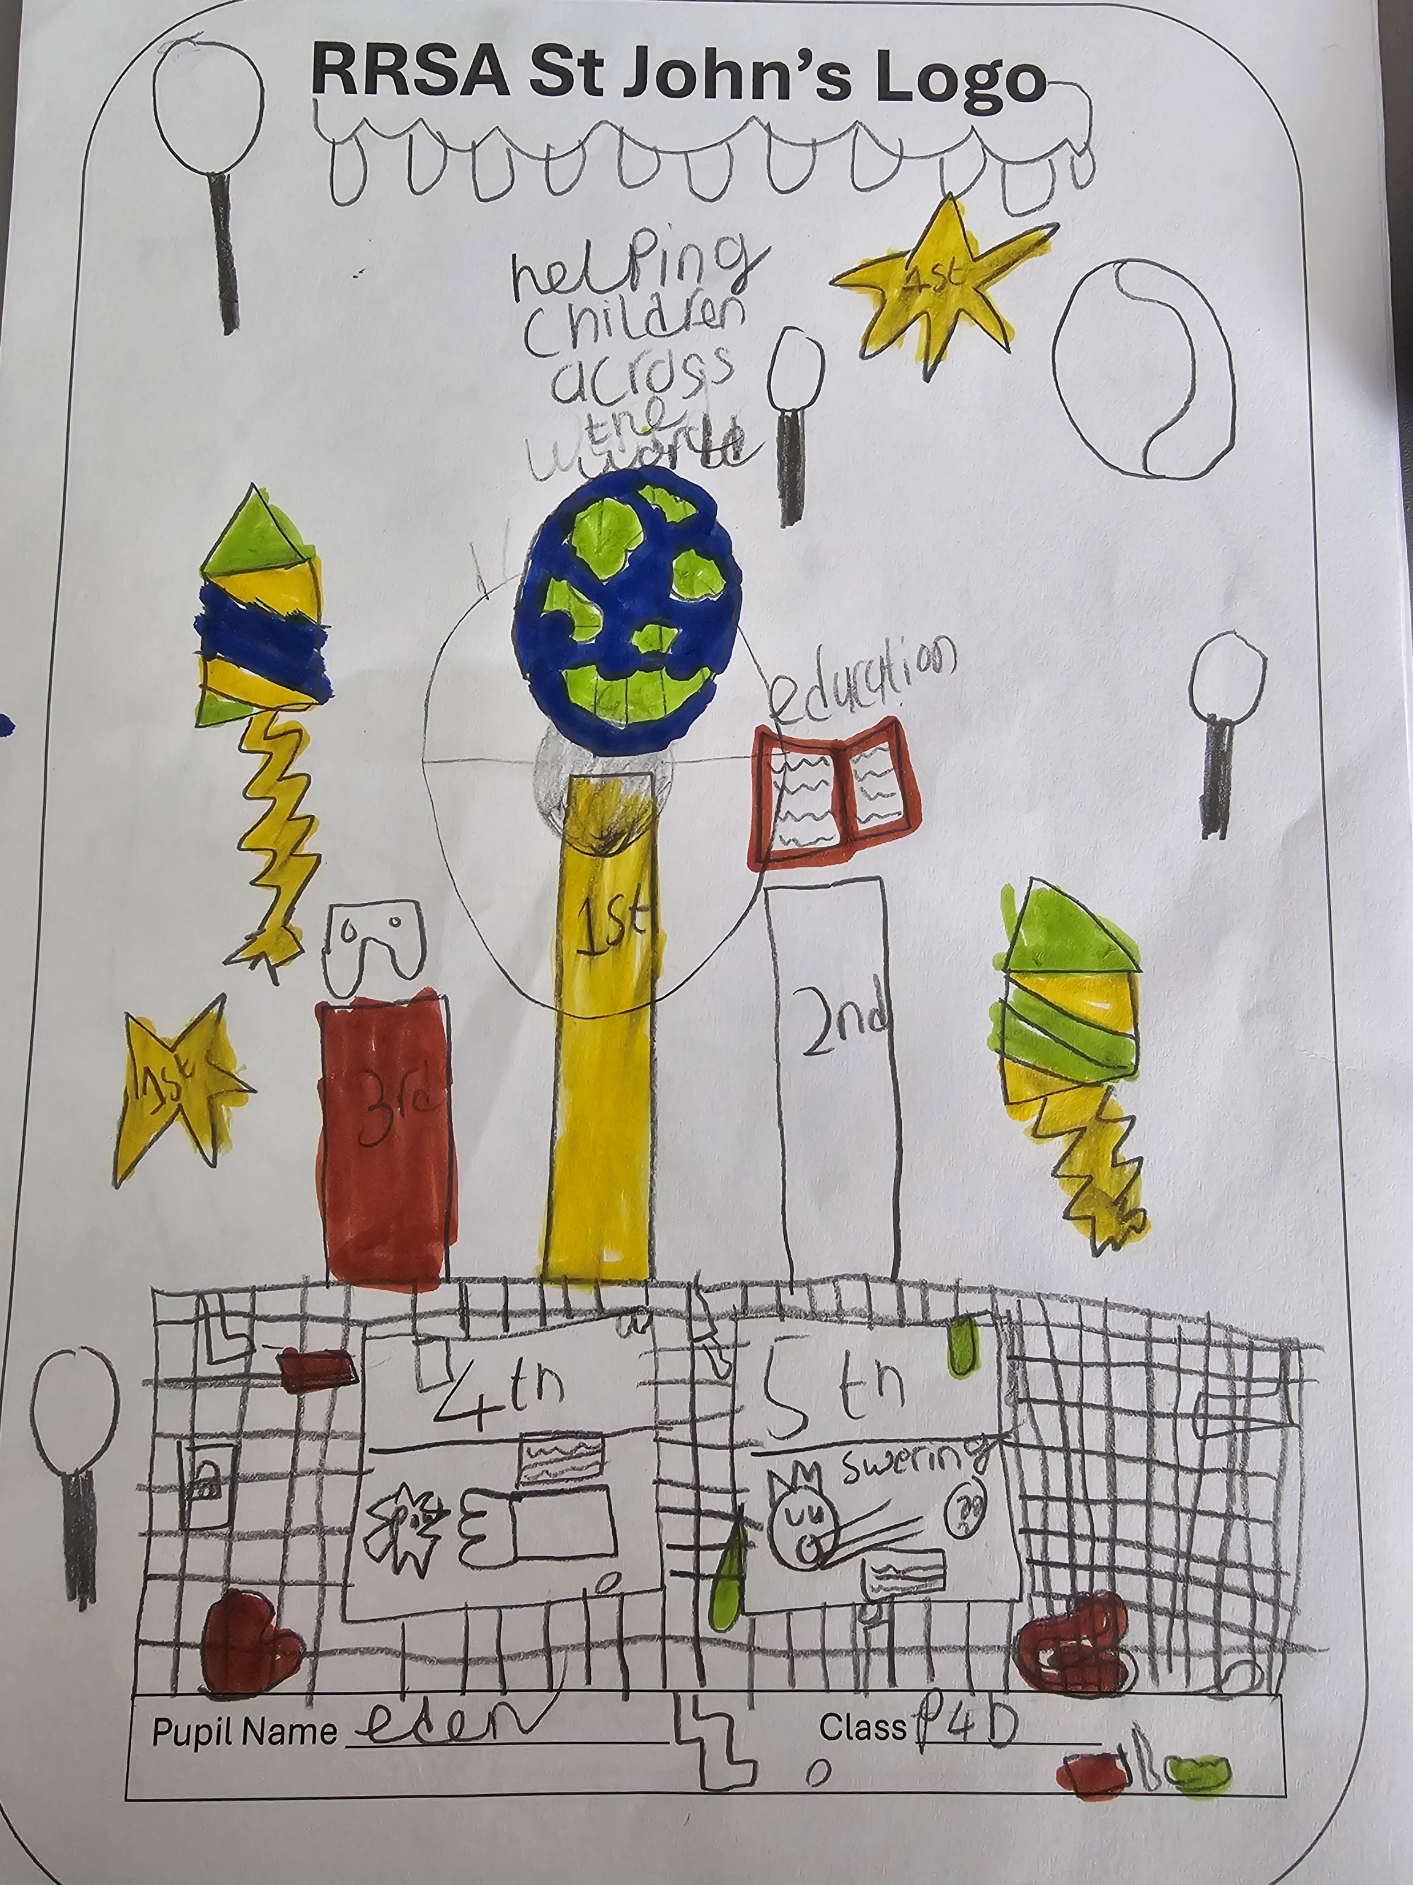
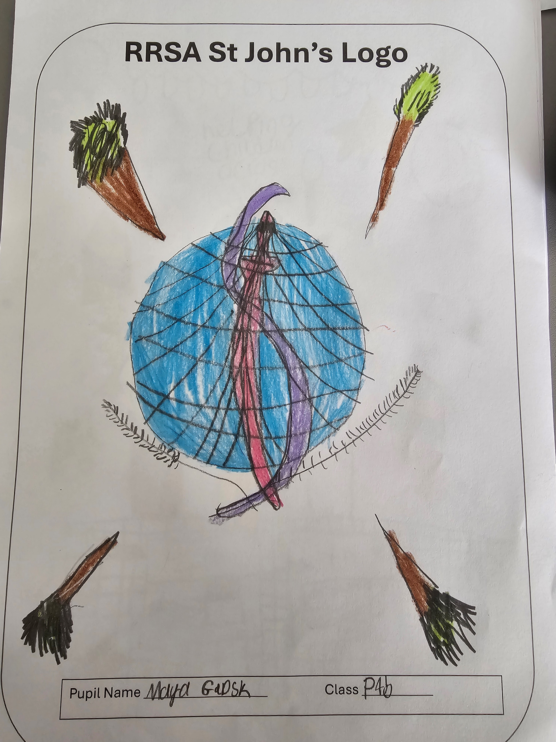

Slide 17
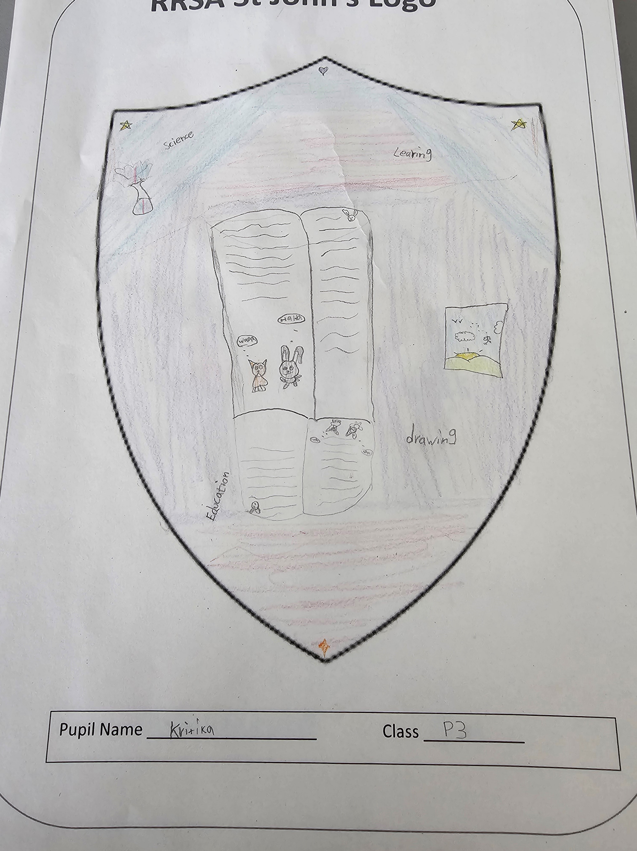
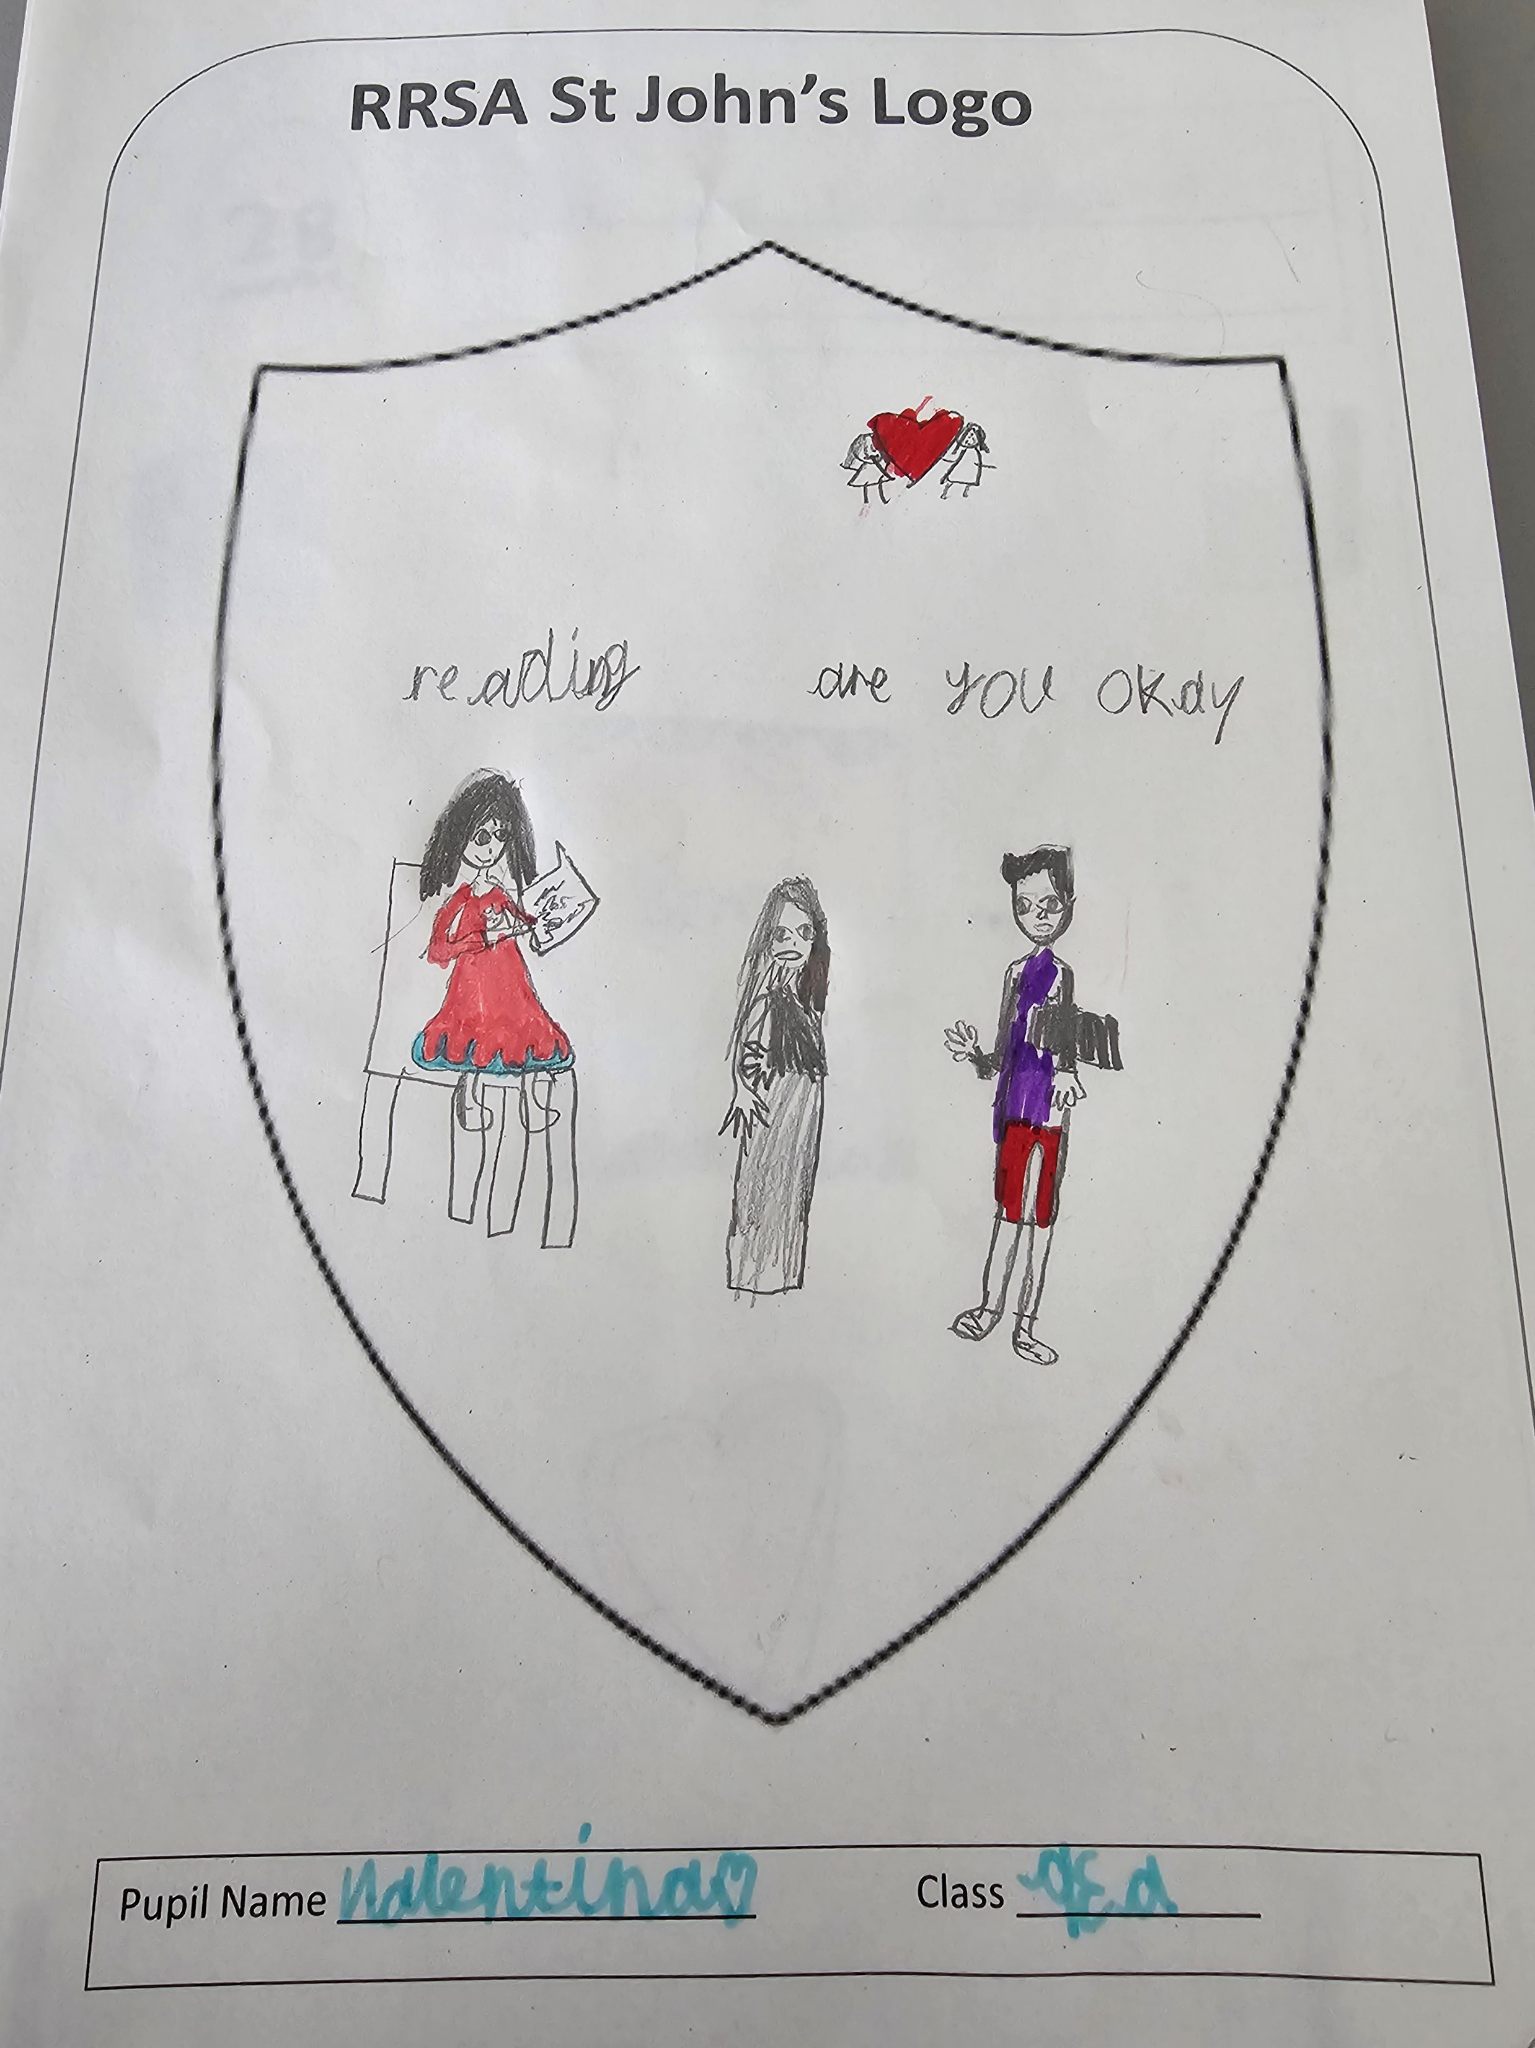
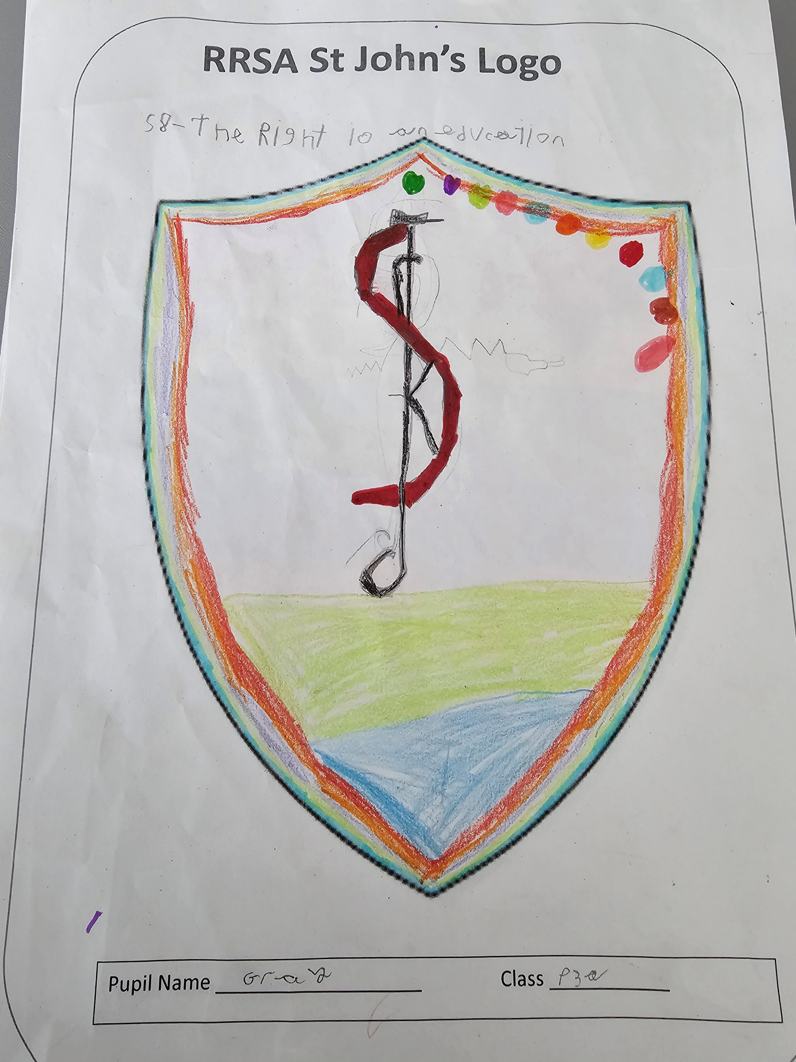
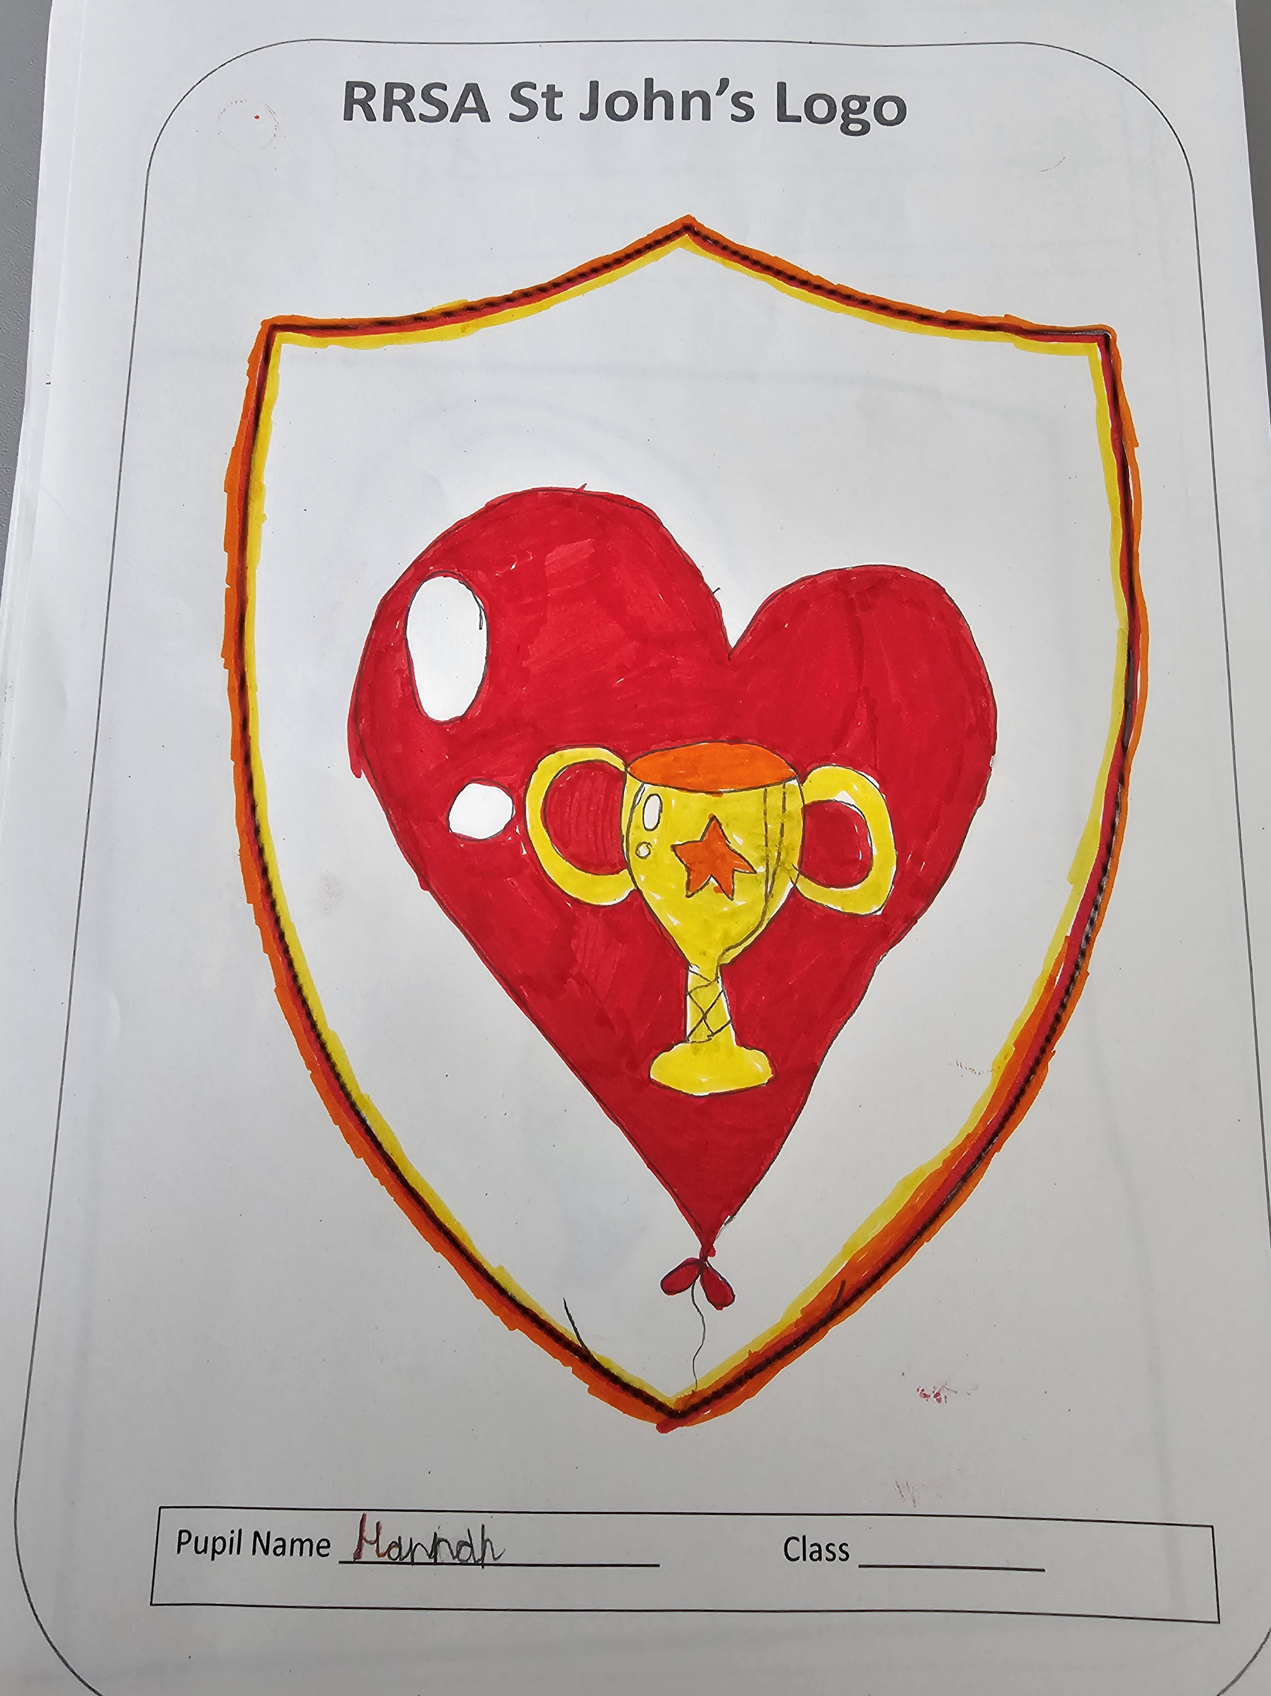

Slide 18
