Slide 1

Dyslexia/
Literacy difficulties
Information Session
for Parents and Carers
City of Edinburgh Council Guidelines
St Johns Primary
School
October 2024

Slide 2
Overview of sessions
Week 1
Overview of dyslexia/literacy difficulties
Strategies to support reading & spelling
Week 2
ICT support with accessibility features

Slide 3
CEC Adopted Definition
‘Dyslexia is evident when accurate and fluent word
reading and/or spelling develops very incompletely or with great difficulty. This focuses on literacy learning at the ‘word level’ and implies that the problem is severe and persistent despite appropriate learning opportunities.’
Literacy and Dyslexia Guidelines:
Definition developed by the British
Psychological Society 1999
Notes:
The CEC definition for dyslexia is taken from the British Psychological Society.
Key points are; ‘word level’, ‘severe and persistent’ and ‘appropriate learning opportunities’.
Word level implies difficulty at the basic level of word building i.e. breaking down and building up words to read and spell. This definition’s focus is on literacy.
Severe and persistent difficulties = this is linked to the age and stage of the child.
Despite appropriate learning opportunities – we must be able to show that the child has had appropriate teaching including additional support in the classroom and from Support for Learning if this is needed over a sustained period of time.
………………………………………………………………………………………………….
EAL considerations. Important to consider
length of exposure to English language – progress through the stages of English within expected timeframes.
Experience of education e.g. in many countries, children don’t start school until 6 or 7

Slide 4



Associated difficulties
Reading
Writing
Spelling
Memory
Reading comprehension
Emotional/
behavioural
Organisation
Processing
Notes:
These are some of the difficulties that are associated with Dyslexia or literacy difficulties
If a child is experiencing difficulties with literacy – this will usually show up in reading, spelling and writing. Sometimes it may be one particular area or it may be 2 or 3. As well as having difficulties here in these specific areas of literacy some learners will often experience difficulties in some of these other areas:
Reading comprehension e.g. difficulty understanding what is read
Processing: difficulty answering a question fully as has forgotten what was asked, slow speed of reading
Short term difficulty holding sufficient information in mind to complete a task, remembers only part of a set of instructions
Organisation skills e.g. forgetting to bring homework/ PE kit
Emotional / behavioural e.g. easily tires, finding homework frustrating

Slide 5

Implications for the pupil
Puzzled / worried
Feels something is ‘wrong’
Hides problem
Adopts strategies – copying/ memorising/ work avoidance
-
Withdrawal /
daydreaming
Frustration/
Behaviour problems
Low self esteem
https://www.dyslexiascotland.org.uk/our-leaflets – Dyslexia and self esteem
Notes:
Many learners facing these difficulties will often go into lessons feeling unable to do anything. They may be fearful that they will not be able to do what is asked of them, facing frequent failure, they may try to hide their difficulties by avoiding tasks or copying from a friend. They may lack confidence in their ability.
Teachers are encouraged to create a nurturing environment, where learners feel supported and able to ask for help. Despite this some children may still feel unable to share their concerns.
Dyslexia Awareness Week is a great opportunity for schools and teachers to discuss Dyslexia with their pupils and look at the difficulties and strengths that many learners have. This can help some pupils feel more confident in discussing their difficulties and not hiding them.

Slide 6

What is it like to have Dyslexia?
First-hand account from Lachlan Rogers
-

Slide 7

Working Memory Hints and Tips to support your child
Working Memory - the ability to hold and use information for a short period of time
Short simple sentences/ instructions
Check he/she can remember instructions – repeat back
Regularly repeat instructions - in the same words
Break processes down into key steps
Give more time to process/ complete activities
Minimise distractions
Provide visual supports
Use colour coding/ numbering – hooks & clues
Model activities
Build on prior knowledge
Notes:
For example, a child is using their Working Memory as they recall the steps of a recipe while cooking a favourite meal.
WM is crucial for learning because it provides a mental workspace in which we can hold information whilst mentally engaged in other relevant activities.
Children with poor working memory have –
Difficulty with focus/easily distracted
Remembers only part of a lengthy sequence of instructions
Misses out chunks of a task
Task abandonment
Difficulty explaining what they should be doing in an activity
Difficulty holding sufficient information in mind to complete a task, eg uses tables to solve sums
Starts a sequence of actions and forgets where got to in the sequence, eg getting ready to go home
Loses track of place in complicated mental tasks
Difficulty writing down information given orally
Place keeping errors, eg skips letters/words in sentence writing
Difficulty retaining information, eg unable to recall previously learned facts
Difficulty recalling common sequences – alphabet, number, days, months

Slide 8

Dyslexic Population
1 in 10 (10%) people
4% with severe literacy difficulties
Range - from mild to severe
All cognitive abilities
Assessment is a PROCESS
Notes:
Stats - Studies suggest 10% of population are dyslexic but it is more likely to be 1 in 5 according to some research
- 4 % of them – severely
Dyslexia is on a continuum from mild to severe
Assessment is a PROCESS - Children with dyslexia have their own pattern of abilities and challenges, therefore we need to build up a profile of each child.
This should take time as we need to consider and whole child and their strengths and needs.
It is ok for this to take time because WHEN A CHILD GETS AN IDENTIFICATION OF DYSLEXIA IT WILL NOT CHANGE THE SUPPORT THEY GET. They should already be getting the support they require.
**Note for presented – it is very difficult to give timings if parents ask. It will depend on practice in your school.
Definition ‘despite appropriate learning opportunities’ e.g. May want to monitor while CTs puts strategies in place at Pathway 1, tries them out and monitors progress/ tries other strategies.
May monitor/ add to information you have as they get RWInc or another Pathway 2 support for a year.

Slide 9
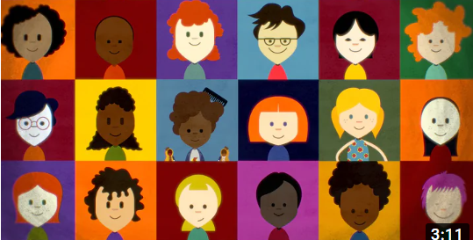
See Dyslexia Differently
Notes:
This is a short video that illustrates some of the challenges faced by dyslexic learners but also the strengths that they may have. This is a message that we are really trying to get across to our learners as sometimes there self esteem and confidence may have taken a bit of a knock.

Slide 10
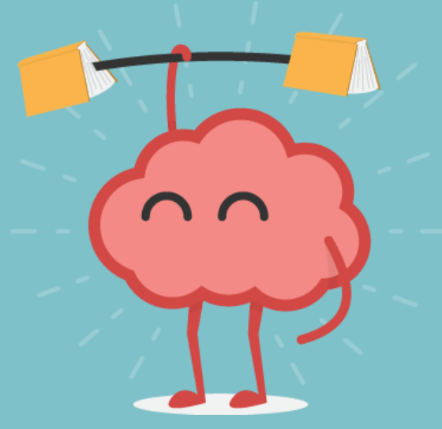
Dyslexia –Associated Strengths
See the bigger picture
Highly creative
Enjoys and good at practical tasks
Picture Thinkers
Problem solvers
Improved pattern recognition
Good spatial knowledge
Good verbally
Strong visual thinkers
Business entrepreneurs
Notes:
It is really important that children understand that dyslexia is a learning difference that has positives too.
As dyslexia affects every child differently, schools are encouraged to identify and take account of the particular strengths and areas for development for each child.
Tell parents about mission dyslexia author visit.
Seeing the bigger picture
People with dyslexia often see things more holistically. They miss the trees but see the forest
Highly creative
Many of the world’s most creative actors have dyslexia, such as Johnny Depp, Keira Knighltly and Orlando Bloom
Picture Thinkers
People with dyslexia tend to think in pictures rather than words. Research at the University of California has demonstrated children with dyslexia have enhanced picture recognition memory
Thinking outside the box – problem solving
Those with dyslexia are well known for having sudden leaps of insight that solve problems with an unorthodox approach. This is an intuitive approach to problem solving that can seem like daydreaming. Staring out of the window is how dyslexics work, letting their brain slide into neutral and ease itself around a problem to let connections assemble
Strong visual thinking skills such as being able to visualise a structure from plans
good verbally, in social interaction and group work
Improved pattern recognition
People with dyslexia have the ability to see how things connect to form complex systems, and to identify similarities among multiple things. Such strengths are likely to be of particular significance for fields like science and mathematics, where visual representations are key
Good spatial knowledge
Many people with dyslexia demonstrate better skills at manipulating 3D objects in their mind. Many of the world’s top architects and fashion designers have dyslexia
Business entrepreneurs
Did you know that one in three American entrepreneurs have dyslexia? Entrepreneurs like Thomas Edison, Henry Ford, Steve Jobs and Charles Schwab were all dyslexic. Perhaps better strategic and creative thinking could provide a real business advantage.
Unfortunately not true of all dyslexics – some may have difficulties in these areas
Lot of research to show there are links with other difficulties eg ADHD,Dysgraphia,Autism,Dyscalculia,Developmental coordination disorder(DCD)/Dyspraxia
Strong visual thinking skills e.g. see/ think in 3D, visualise a structure from a plan
Good a problem solving = thinking outside the box, seeing the whole picture
= ask them to suggest solutions to problems and they often have an effective answer

Slide 11

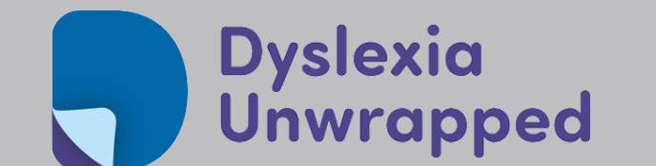
Useful Websites
Made by Dyslexia
Dyslexia Unwrapped
Notes:
Dyslexia Unwrapped is an online resource provided by Dyslexia Scotland. It is a resource aimed at young people with dyslexia aged 8 – 18, but also has information for parents.

Slide 12

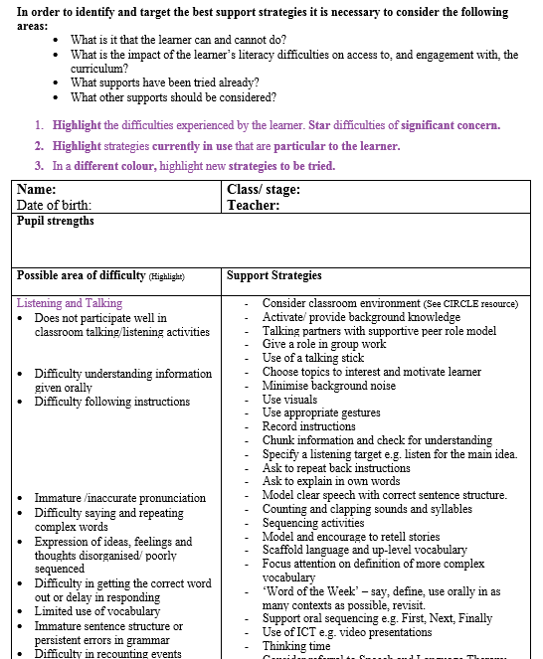
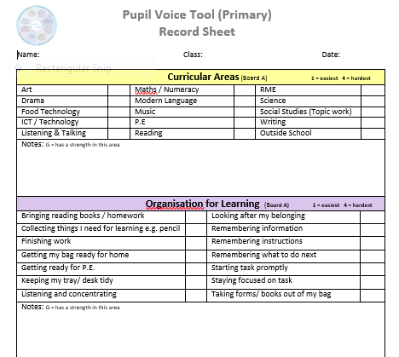
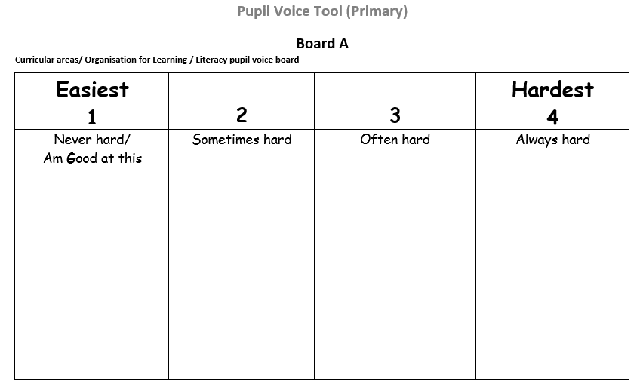
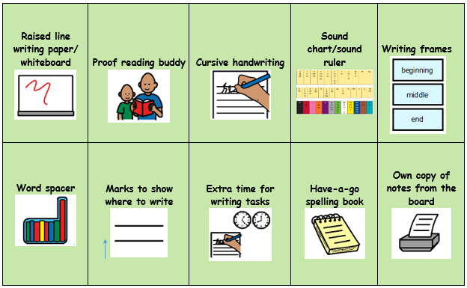
Identification and Support in School
School staff can identify dyslexia
No external assessment needed
Educational Psychologist not required
Main Tools
Checklist
Parent/ Carer information form
Gather evidence over time
Pupil views
Dyslexia Identification Report
Support/ advice available to school from ASL Service - Literacy / Dyslexia Support Team
Notes:
Focus of guidelines and support – the classroom
Terminology IDENTIFICATION (not tendencies or diagnosis)
No one test to identify a child as having dyslexia
Identification is a STAGED PROCESS
NOT a one-off test
An identification should not change the support –support should already be in place based on observed strengths and barriers that prevent success in class
School staff are trained to identify dyslexia
- so parents don’t need to go for external assessments
Educational Psychologists not required but can advice school staff for complicated cases and as second name in sign off.
Main tools for assessment –
– Checklist (for use by CTs and SfL)
- Parent/ Carer information form (to get
parent/ carer view)
- discussion with child
Dyslexia Report - used by SfL to record evidence. It is the final report and is used as the basis for identification of dyslexia – there is a section for the conclusion.
Two professionals sign it off.
Support/ advice on this process is available to school from CEC Literacy/ Dyslexia Support Team

Slide 13
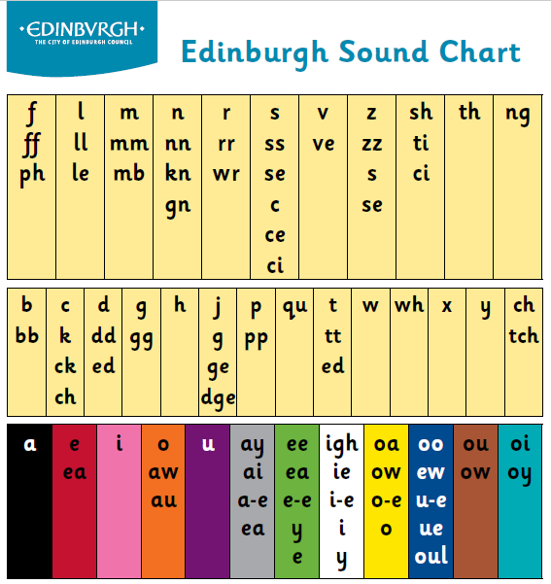
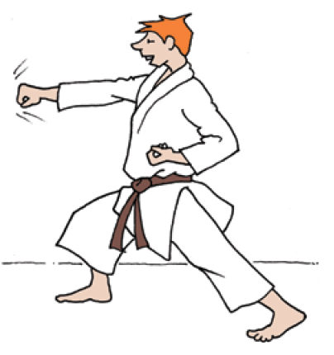
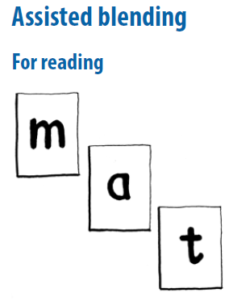

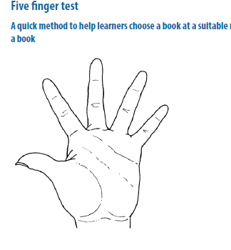
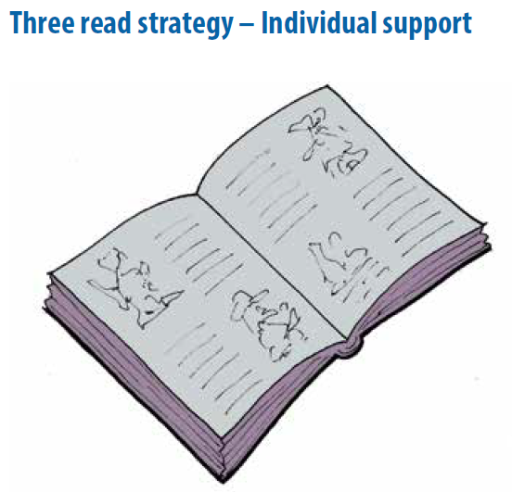
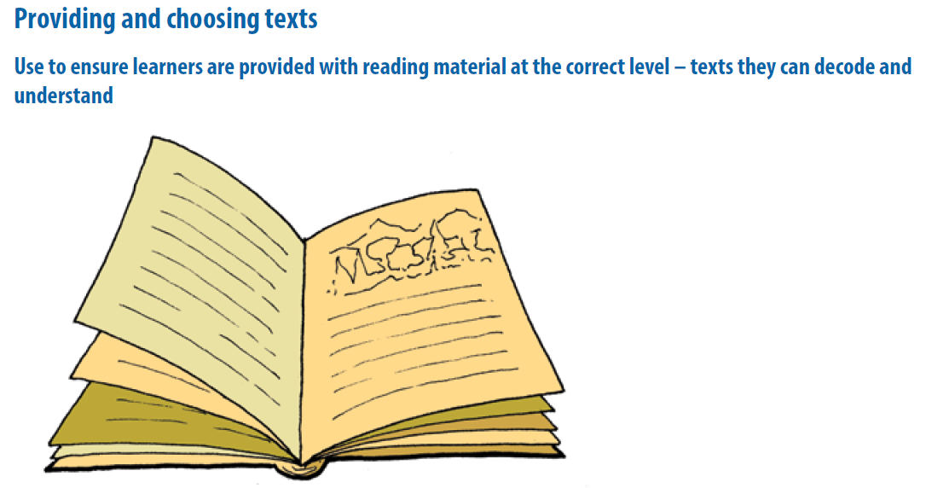
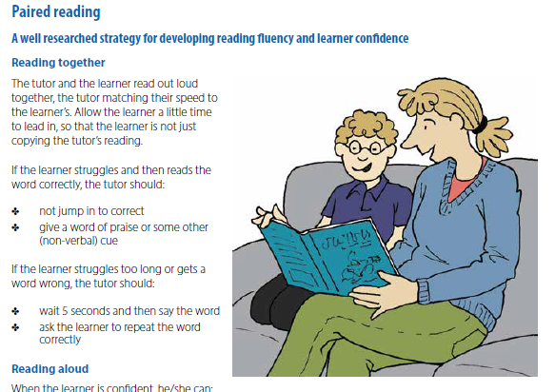
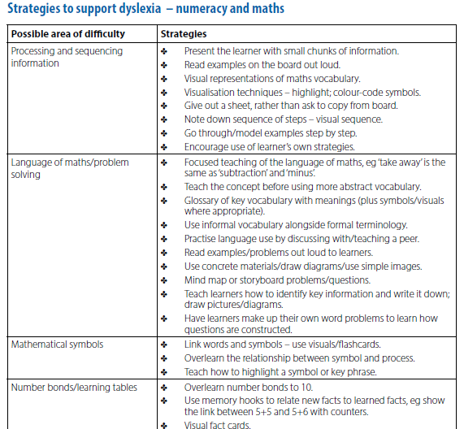
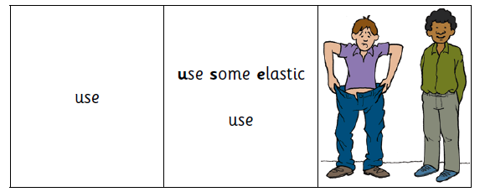
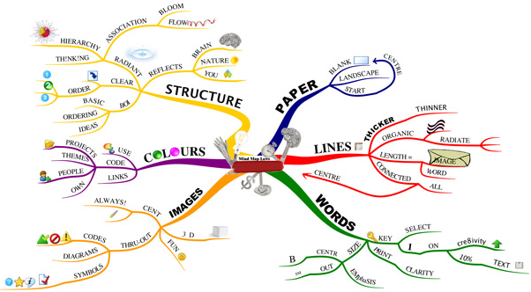
Strategies and Resources -helpsheets
Notes:
Within the guidelines are a wide range of assessments, advice and strategies for teachers and support staff

Slide 14
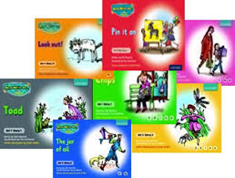
Literacy Support in School
Universal Supports (in class)
Checklist
Visuals – sound charts, tracking rulers, modelling, visual examples
Adult support - Class teacher/PSA
Differentiated tasks
Targeted Support (individual or group support with SFL or PSA)
Phonics
RWI
Fresh Start
Toe-by-Toe
Reading
Writing
Notes:
Explain different levels and pathways of support. Give examples of pathway 1 and pathway 2.

Slide 15
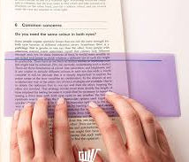

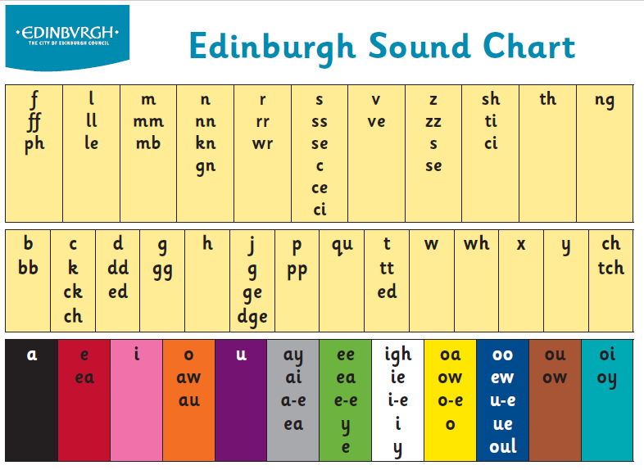

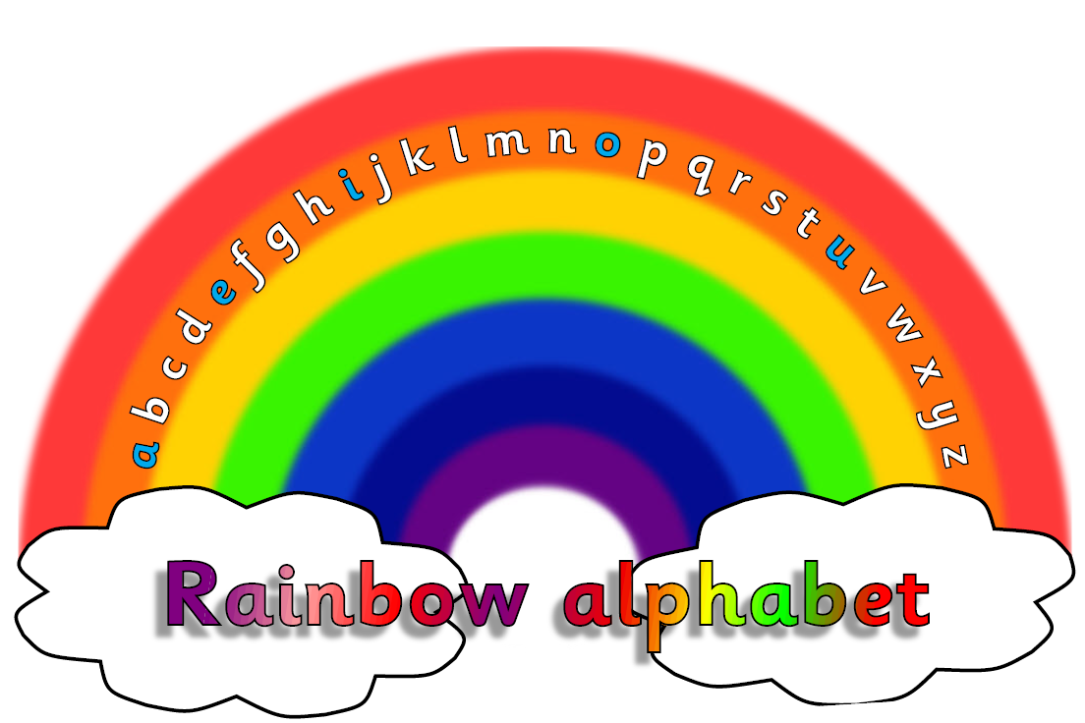
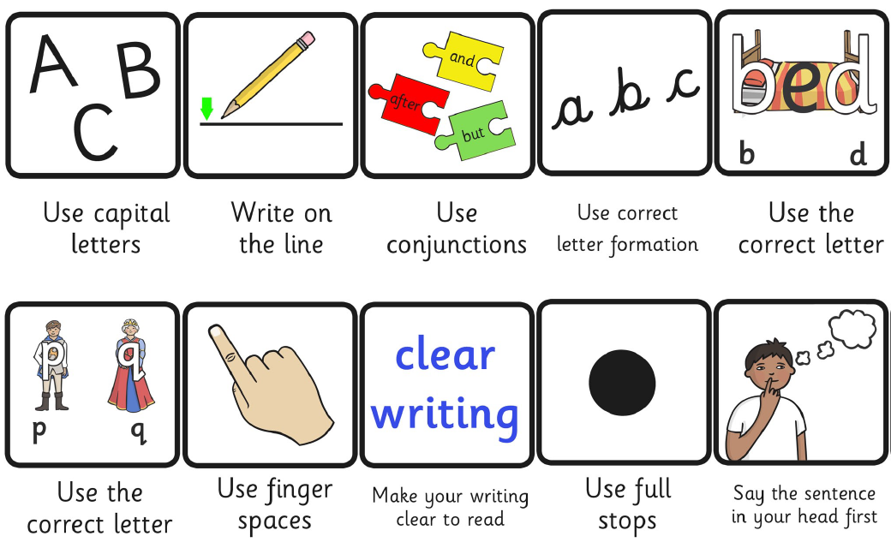
Resources to support
IPADS
Overlays
Coloured jotters
Sound charts
Decodable books
Visuals
Spell checkers

Slide 16
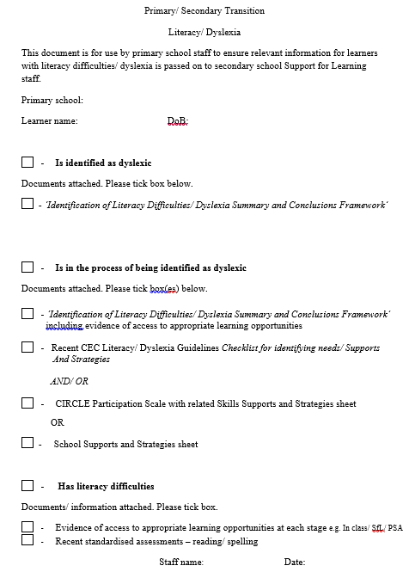
Supporting effective transitions
Before the early years stage
From early years to primary stage
From class to class in primary
From school to school (e.g. child/ young person moving into the area)
From primary to secondary stage
Primary/ Secondary Transition –
Literacy/ Dyslexia form
Notes:
Primary and secondary school staff work closely together to ensure a smooth transition. Transition arrangements ensure high school staff are made aware of the additional support needs of each child.
Guidelines also include comprehensive information on transition and sharing information on meeting literacy needs at each of these stages – see slide.
Form in guidelines for use by primary school staff to ensure relevant information for pupils with literacy difficulties/ dyslexia is passed on to secondary school Support for Learning staff.
– talk through

Slide 17


Questions
Feedback
Notes:
At end provide copies of all leaflets to parents – as appropriate.
How I can help at home - Advice for Parents/ Carers (Primary)
Dyslexia: Information for parents/ carers of Primary school children
Dyslexia: Information for child (Primary)

Slide 18
Reading and Spelling strategies

Slide 19
How do children learn to read?
Phonic words c-a-t
Common words said
e.g. I have a black cat.
The dog is in the garden.
Notes:
Before we go into the details of the supports, we want to give you an overview of the process of teaching children to read as this informs our approach in school.
When we are teaching reading we are approaching it from 2 angles: – phonics based reading and common word reading as described on the slide.
THE KEY PART OF THE LDST SUPPORT PROGRAMME IS a PHONICS approach because learners with literacy difficulties often get stuck at this stage.
To be able to read, children need to know the sounds (phonemes) and the letters which represent those sounds (graphemes.) They need to be able to blend those sounds together to read words, as well as recognise the common words which can not be sounded out e.g. ‘said.’
Often for learners who are struggling to read, they have difficulty decoding (using phonics) and may also be confused about which words they can sound out and which words need to be read as ‘whole’ words. We also support learners to read common words automatically.
Phonics – sounding words out or a method of teaching beginners to read and pronounce words by learning the phonetic value of letters, letter groups, and especially syllables.
Common Words - the most common words used in English, listed in order of frequency, and include all parts of speech. Also known as Fry sight words or high frequency words, they must be easily recognized in order to achieve reading fluency.

Slide 20
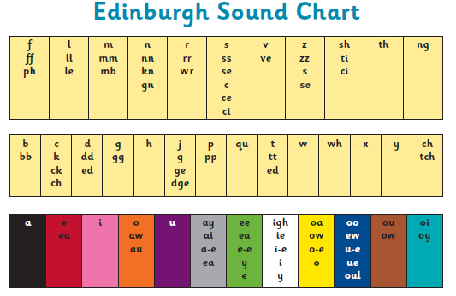
stay
hair
same
break
coat
snow
home
go
flip
huff
phone
Notes:
The Edinburgh Sound Chart is a tool we use to support the teaching of phonics. This chart shows us that for these 37 sounds that are represented in each box, often there is more than 1 way of writing the sound. In fact sometimes we have 2,3,4 or even 5 ways of writing the same sound.
So if you look at the chart. Each box is a sound box and within each box are the different ways a sound can be written. For example if you look at the first box – it is the ffffff sound. This can be written in 3 different ways.
The bottom row of the chart is the vowels and vowel digraphs which are colour coded to help children remember…. The colour corresponds with the sound e.g. a in the black box, e in the red box, ay in the gray box and so on...
Activity with finger spelling

Slide 21


Reading - Hints and Tips to support your child
Be encouraging and understanding. Help them find their own strategies
Talk about the book/ pictures before reading
Help them find books or text that they are motivated to read
Read a bedtime story to your child
Notes:
Daily reading is best, for 10–15 minutes at a time - less for younger. More if child wants to.
Children who are reluctant to read could be encouraged to choose picture books, comic books, graphic novels, the sports page - whatever they feel comfortable with and are interested in

Slide 22
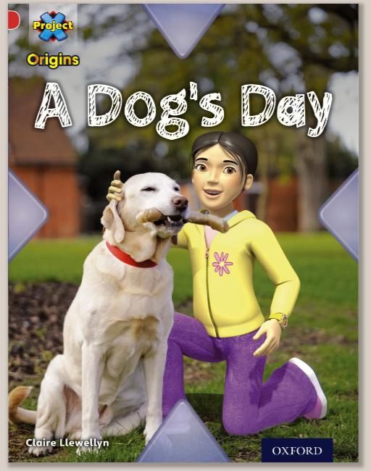

Reading – Resources and websites
Call Scoltand: Books for All - booksforall
EPIC!
DEKKO Comics
Oxford Owl website Oxford Owl ebook
Chapter books with combination of pictures and text
Barrington Stoke
Audiobooks:
Library app - Libby
Audible app
Listeningbooks.com
BBC Scotland – Time for a Story
Notes:
Books for All (http://www.booksforall.org.uk/finding-books/Books-for-All-Database) has a huge range of books that are available in PDF form. These could be downloaded in advance on to the iPad and could be read through a reader app or utility. These e-books are available for free to any child who has an additional support need (with the exception of EAL).
EPIC! – app- Can’t be used in schools because of Date Protection. Can use at home. Ebook library for 12 and under. Put in child’s interests and age and it will make a personal library with fiction/nonfiction material. Over 10,000 books and thousands of audio books
Oxford Owl – free ebook library, some have audio to read along with
Graphics novels – 5- best - * for older childs
Your child can also listen to / read along with audiobooks – free from local library
Audible – app – monthly cost
Listening books – cost/ deals (to schools) for childs with dyslexia

Slide 23

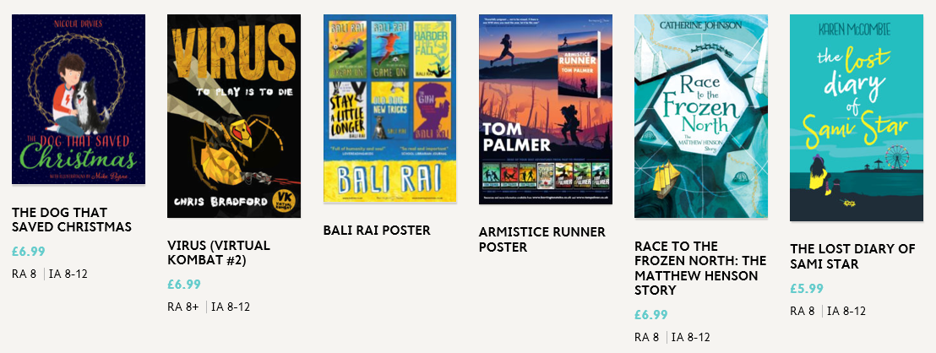
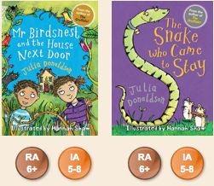
Barrington Stoke
Non-patronising, high-interest, lower reading age books for struggling readers,
written by first-class authors.
Printed on high-quality cream or off-white paper - more restful on the eye
Specially modified font to encourage a smooth read
https://collins.co.uk/collections/barrington-stoke

Slide 24

Is your child reading at a suitable level?
Five finger test
1 finger: this book is ok
2 fingers: still good
3 fingers: could give it a try but it could be a bit hard to understand
4 fingers: could be too difficult to read and understand
5 fingers: should choose another book
Notes:
Too many of our children have/ choose books they can’t read.
Important to check this and help them access books they can read.
Five Finger Test
A quick method to help children choose a book at a suitable reading level and to check the reading level of a book
The child chooses a book. He/she:
opens the book near the middle
reads the page aloud
puts one finger up for every word he/she does not know or can’t pronounce
If the child has five fingers up, the book is too difficult to read without help
If the child does not run out of fingers, but is reading very slowly and decoding almost every word, he/she will not understand or enjoy the book
Five finger guide
1 finger: this book is ok
2 fingers: still good
3 fingers: could give it a try but it could be a bit hard to understand
4 fingers: could be too difficult to read and understand
5 fingers: should choose another book

Slide 25
Three Read Strategy
Introduce story
Read 1 to decode independently
Read 2 to comprehend
Read 3 for fluency & expression
Notes:
Decoding and comprehension
The three read strategy is a strategy that we use in the LDST to support reading and comprehension. It can be used in English classes, or some aspects of it could be used to support reading in other subjects.
Important for learners with literacy difficulties that they are not expected to read out loud, especially with a text they have not seen before or that may be at a level which is too hard for them. We don’t want to set them up to fail as they may not be able to decode it.
We can support them with this by providing pre reading discussion, teach vocabulary in advance, providing text to speech, or paired work.
The three read strategy allows learners to build skills stage by stage to allow them to access the text fully by doing one thing at a time. It is important to mention here that the 3 read strategy needs to be used with text of the correct level.
Decoding first – can be- done in pairs taking turns
Comprehension second – teacher models think out loud as reading
Fluency and expression – teacher models and then learners have a go
It is worth remembering that many learners will still be at the decoding stage so we need to support them with the different opportunities we can provide to read/reread/discuss and process the text before we ask them to do anything with it.
(EAL consideration – Bilingual learners may need to have culturally specific themes/concepts explained to them, e.g. Jumble Sale, Pantomime, Pick your own fruit etc.
Best practice would include asking learners for some words in home language and to use some culturally inclusive texts)

Slide 26
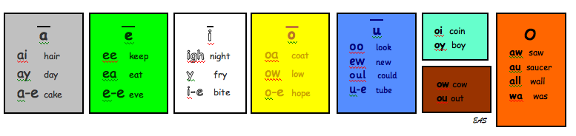
Spelling Hints and Tips to support your child
Learning spelling words:
Little and often is best
Use as many senses as possible:
Look, Say (sound out), Cover, Write, Check
Try ICT games, colour, rap, singing
Simultaneous Oral Spelling – to learn common words
Finger spelling
The Edinburgh Speed Sound Chart/ Sound Ruler
Notes:
Help your child to learn their spelling words, encouraging the use of as many senses as possible:
Strategy - Look, Say (sound out), cover, Write, Check
SOS (Simultaneous Oral Spelling) for Common Words – See help sheet in guidelines/ next slide
Speed sound chart – used in school to support spelling and writing.
2 versions – 1 –as above. 2 – add on prefix/ suffix
Sound ruler – great support to use when supporting to work out which phonic pattern should be used in a word
Keep beside you when spelling / writing – refer to.
School can give you copies.

Slide 27


Finger Spelling / Finger Writing
o
sh
p
shop
Notes:
Finger spelling is a multi-sensory spelling strategy that gives learners an opportunity to visualize, say and feel the position on the sounds in a word. It gives learners time to plan and prepare before writing. This is phonic strategy and we would use the sound chart as a visual aid to support when spelling on our fingers.

Slide 28
Simultaneous Oral Spelling (SOS)
Used to learn spelling of common words (tricky words)
Fry’s list
Words child uses a lot in writing
Parent prints word, saying letter names
Parent says whole word
Child repeats word
Look for tricky bit together -highlight
Child writes in joined script, saying letter names as writes
Child repeats word
Child does this 3 times
Parent covers words
Child writes word and checks it is correct
Notes:
Fry’s list – used in CEC schools. List of 1000 most commonly used (high frequency) words. Usually have a tricky bit in the word. Focus – 1st 300.
Listed in order of most commonly used
Activity – practise together on white boards
Main points-
Adult PRINTS word
If child does not know the letter names, can use letter sounds. Don’t mix – use names or sounds. Aiming for letter names.
If child can’t do cursive, printing is fine. Aiming for cursive = child feels flow of the spelling.

Slide 29


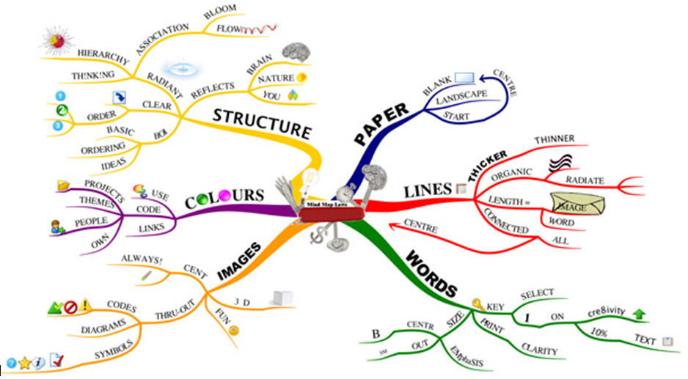
Writing
Hints and Tips to support your child
Encourage as many opportunities to write/type as possible e.g. the food shopping list
Discuss together to help to understand the task
Help generate ideas before they start work
Plan/ organise thoughts using Mind Mapping
Collect key/ interesting words
Encourage to learn touch typing skills using a typing program
Doorwayonline/ BBC Dance Mat/ Typingclub.com
Notes:
Encourage as many opportunities to write/type as possible, following your child’s interests/ home life
Collect key/ interesting words to use when writing
As they get older, encourage them to learn touch typing skills using a suggested typing program.
www.doorwayonline.org.uk/ Doorway Online – Typing
www.bbc.co.uk/bitesize/articles/z3c6tfr - Dance Mat Typing
https://www.learninggamesforkids.com/ – Learning Games for Kids
www.freetypinggame.net/play.asp - FreeTypingGame.Net
https://sense-lang.org/typing/ - Typing Tutorials - Games

