Slide 1
Annual General Meeting
Parent, Teacher Association, St John’s RC Primary School
Laura Lowden
August 2023 – June 2024

Slide 2
Agenda
1.Summary
2.Our Team & Recruitment
3.Halloween Disco
02. 02. Team and Recruitment
Team and Recruitments
4.Christmas Fayres
5.Active Schools
6.Gardening Gang
7.Edinburgh Marathon
8.Summer Fayre
9.Anti Bullying Workshop

Slide 3
Summary
The school year August 2023 to June 2024 was packed full of fundraising events including two Summer Fayres, Halloween Discos and also ongoing programmes supported by the PTA including Gardening Gang and Active schools.
Special thanks must go to all the parents, teachers and staff that volunteered throughout the year without whom fund raising would not be possible.
Thank you to Mrs Kelly and Mr Burgess for supporting the PTA.
I would like to extend a huge thank you to Claire for all her hard work in her role as Fundraiser. It is Claire’s drive and ideas that have facilitated countless events over recent years.
Colm is also stepping down at the end of his 4 year tenor as Treasurer. Colm has been the oracle for all our financing needs and I want to say a huge thank you to him for his invaluable contribution to the PTA.
This report highlights the major events and activities supported by the PTA during the course of the school year.

Slide 4
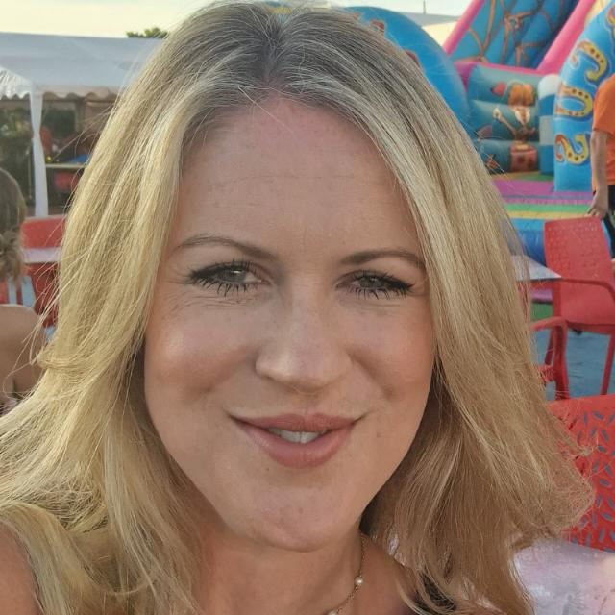
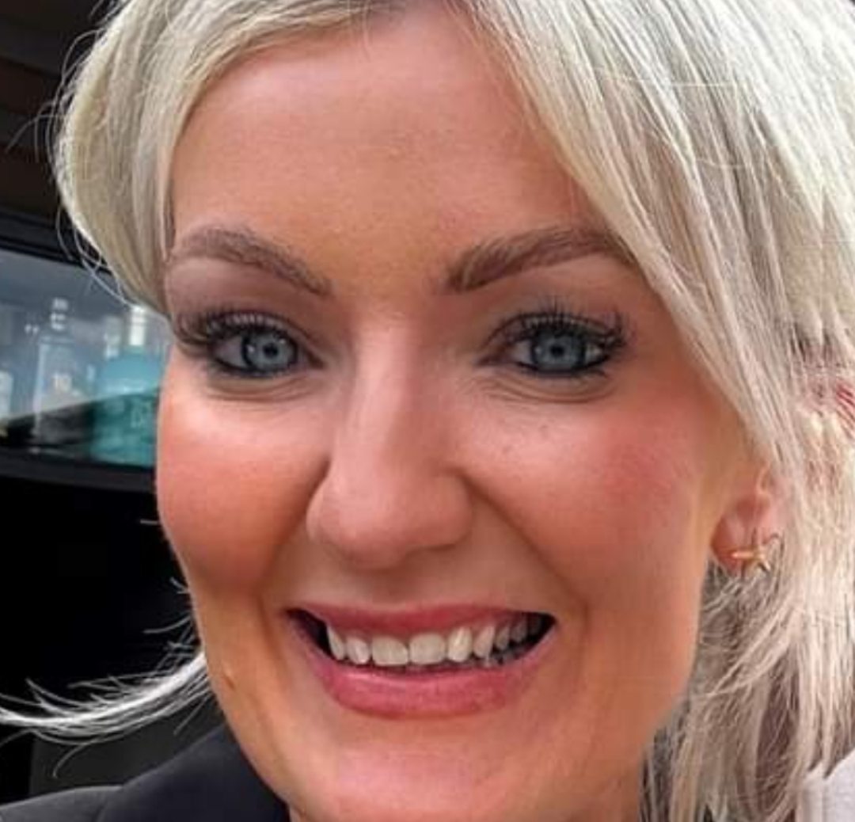
Our Team & Recruitment
THIS COULD BE YOU!
Laura Lowden
Katy Graham
Chair
Secretary
Treasurer
Treasurer Recruitment
As Colm steps down in this role, we are actively looking to recruit his replacement. I would ask anyone interested to please get in touch. This role is essential to the continuation of the PTA, without which we will not be able to exist. Colm has kindly prepared a handover and will support any candidate in the transition to him stepping down.
Fundraising Committee
Claire proved difficult to replace so we are proposing a new approach to fundraising and we’re going to assemble a Committee to drive forward our fundraising efforts. A huge thank you to Arianna, Fatima and Amy who have all volunteered to be involved. We look forward to working together in the coming year.

Slide 5
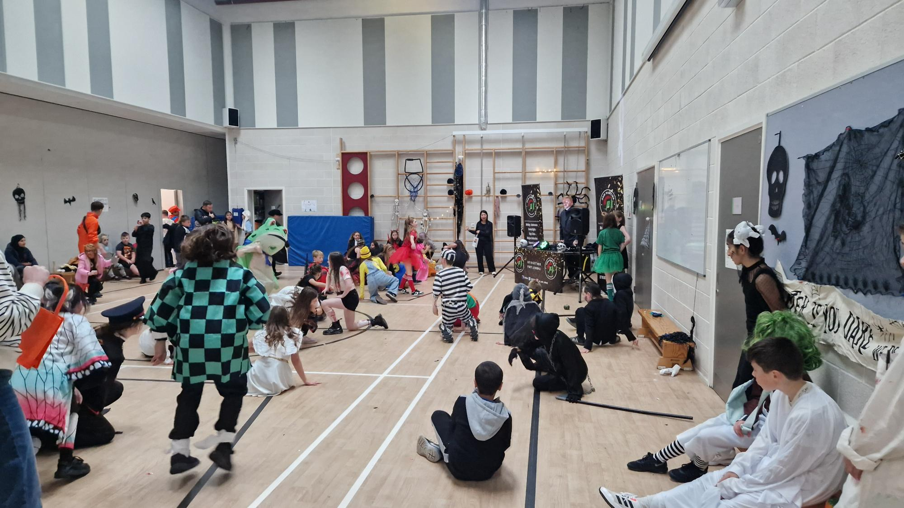
Halloween Disco
The PTA hosted Halloween Discos for both the P1-P3 and P4-P7 year groups. The children made a fantastic effort with their costumes and loved the DJ’s games and music.
Ticket sales and the ever popular Tuck Shop helped to raise £405.42.

Slide 6
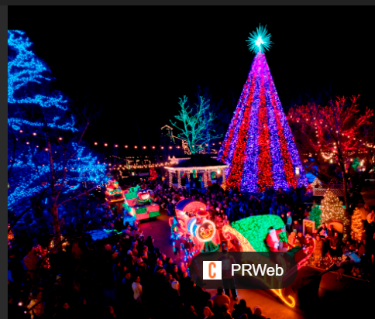
Christmas Fair
We brought the festive vibes again with our much loved and well attended Christmas Fair. The children even got a visit from a very special guest!
The raffle and Christmas cards and mugs designed by the children made a great contribution to the fundraising.
Funds raised totalled £1,463.37.

Slide 7
Active Schools
We continued with an Active Schools programme throughout the year.
Whilst the free offering was reduced additional classes were available at a chargeable cost and classed as a St Johns RC activity and not Active Schools.
The PTA contributed £1,996 throughout the year to fund the activities.

Slide 8
Gardening Gang
Tana continues to work with the children in the garden, growing a variety of flowers, fruits aand vegetables and learning about how plants grow.
In October, P5 were hoping to grow plants that bees will love and were rewarded with some visitors! It was also harvest time for all the salad and herbs planted and the children got to take home some healthy treat bags.
Using the hand lenses funded by the PTA, the children were exploring the garden.
In May the Garden Gang planted potatoes and in June the P5 children enjoyed earthing up the potatoes in order to grow more.
The school website has wonderful photos the children have taken over the course of the year.
The PTA contributed £2,049.46 to support this valuable activity.

Slide 9
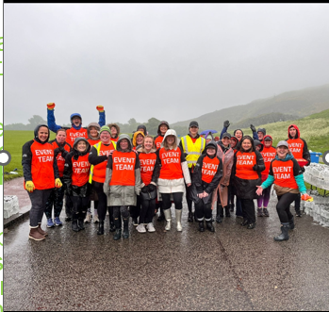
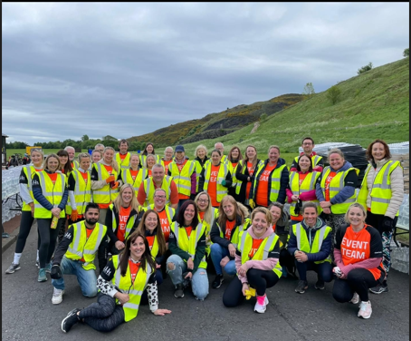
Edinburgh Marathon Festival
The PTA now has a yearly commitment to service a water stall during the Edinburgh Marathon in May.
Unlike the previous year, we were unfortunate with the weather and think we were wetter than the water we were handing out to the runners!
This is a great fun event supporting a huge local event, seeing inspirational runners, meeting parents and carers of our school community and getting to sample some great home baking!
This event raised a huge £1,200 for the PTA.

Slide 10

Summer Fair
The PTA has hosted 2 Summer Fayres in the school year 2023/2024.
The first in September 2023 raised £1,052.
We were lucky to have a beautiful sunny day for the 2024 Summer Fair. The children loved the inflatables, pony rides and emergency service vehicles.
The BBQ was also a huge success.
The event raised £1,432 for the PTA.

Slide 11
Anti Bullying Workshop
Following a successful visit with Scottish Opera in 2023, we were keen to continue the theme of theatre within the school.
This time we wanted to involve the whole school and explore the tricky subject of bullying. Inspire Theatre Group spent a full week at the school holding workshops with each year group which culminated in a whole school performance that helped communicate on a deeper level the impact of bullying.
Kids had fun whilst learning and growing which is exactly what we had hoped for.
Feedback was on the whole positive although it was felt that some workshops could have been better tailored to the age group of the class. Introducing the children to theatre and the powers of is message was the overall aim and I believe we achieved that.
PTA supported this event at a cost of £3,176.

Slide 12

Thanks to the school community for its engagement, by working together we can really help positively shape the children’s experience in their formative years.
Laura Lowden
lauralowden@hotmail.co.uk
07779781883

