Slide 1






SCHOOL IMPROVEMENT JOURNEY
Growing in Faith, Learning for Life

Slide 2
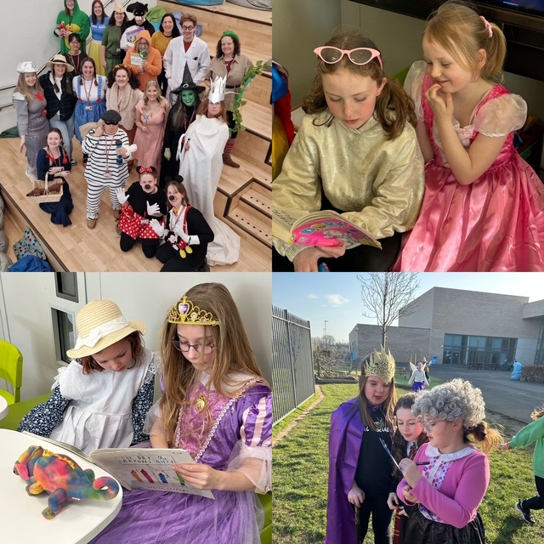
WELCOME
Welcome to a new school year. In this presentation you will learn:
Purpose: Share our improvement priorities and how families can be involved

Slide 3
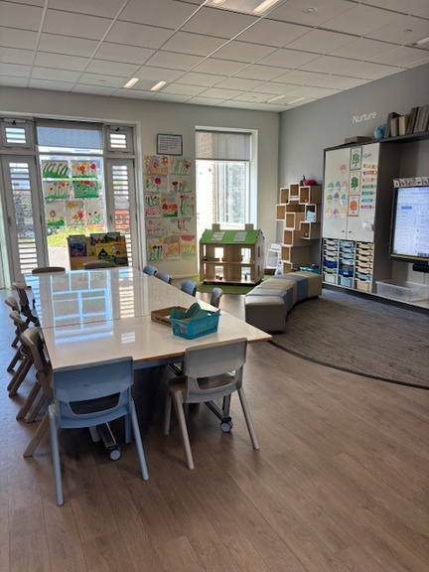
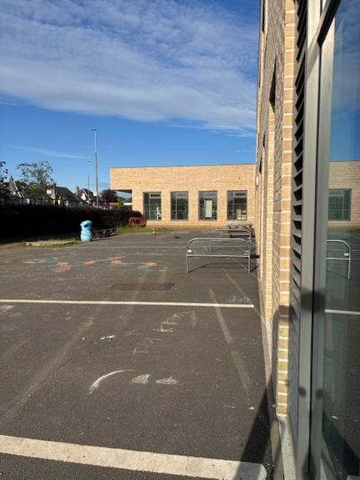

AT THIS SCHOOL WE LOVE TO LEARN

Slide 4

OUR IMPROVEMENT PRIORITIES
We evaluated our standards and quality plan and identified 3 areas for improvement:
Refreshing Our Curriculum Rationale
Raising Attainment in Numeracy
Learning for Sustainability & Outdoor Learning

Slide 5
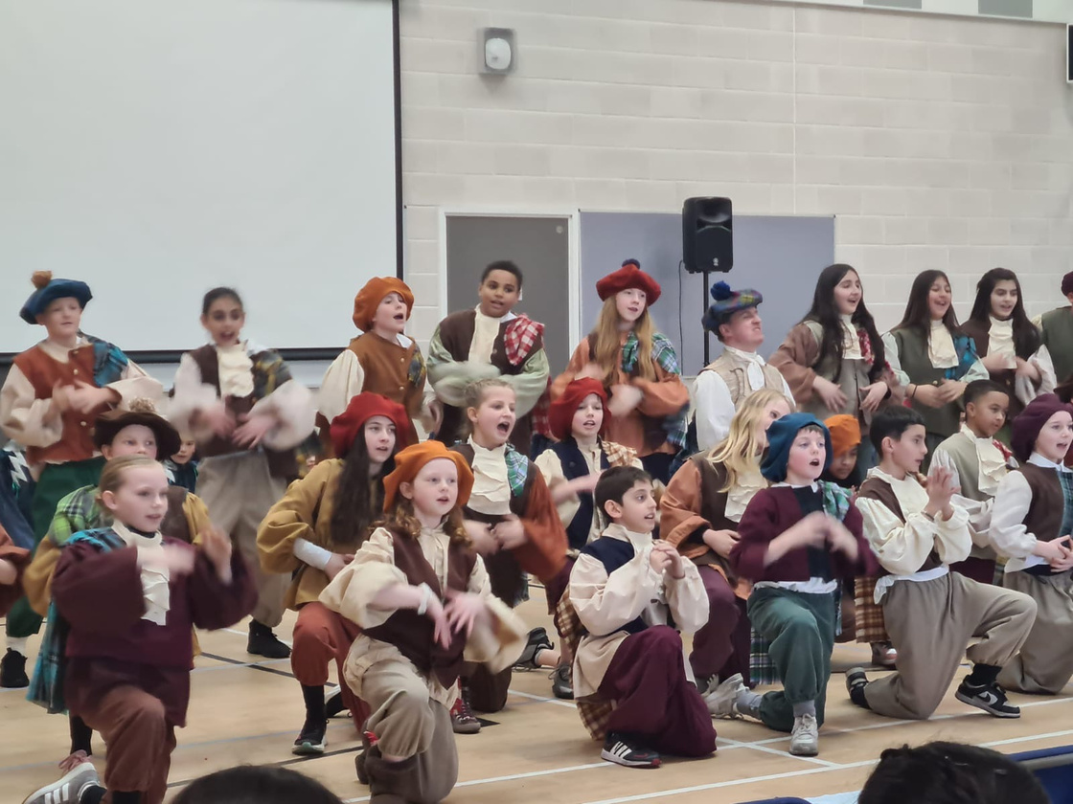
OUR CURRICULUM
What is Scotland’s Curriculum (for Excellence)?
Notes:
Simplified, there are four core purposes of CfE form the basis for all teaching and learning:
.
.

Slide 6
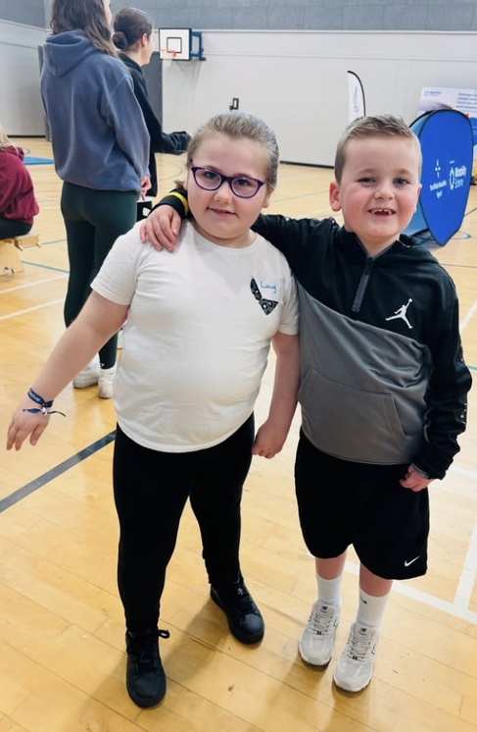
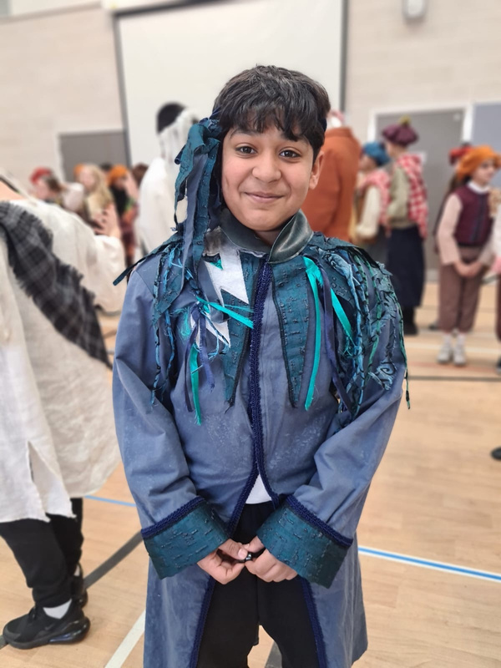
SUCCESSFUL LEARNERS
CONFIDENT INDIVIDUALS
Notes:
Successful learners: This includes being enthusiastic and motivated, developing independent and creative thinking skills, and applying different kinds of learning in new situations
Confident individuals: This involves having self-respect and ambition, being self-aware, and pursuing a healthy and active lifestyle.

Slide 7
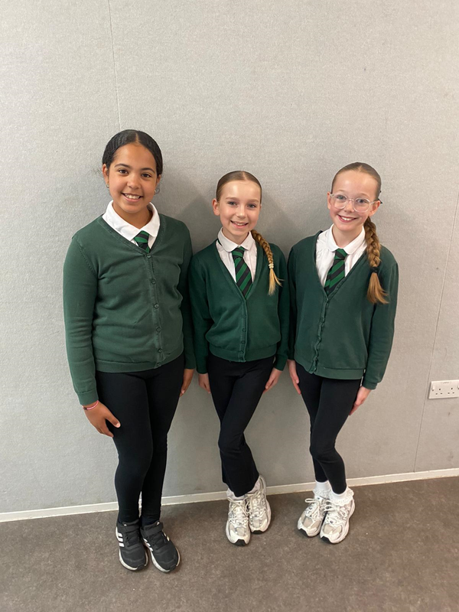
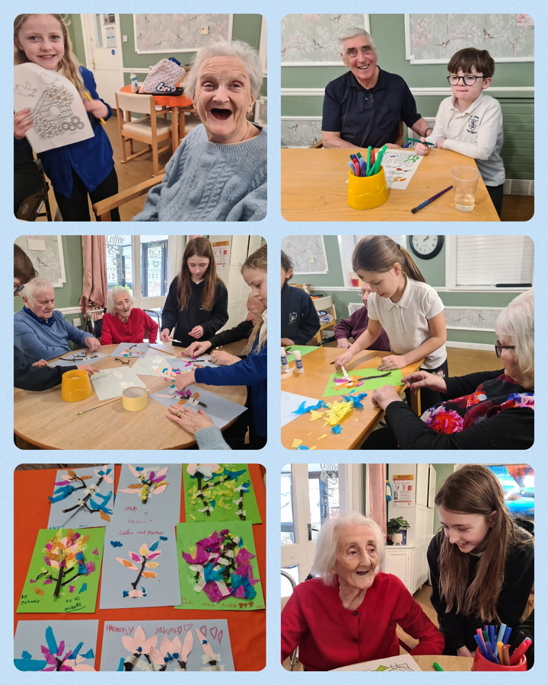

RESPONSIBLE CITIZENS
EFFECTIVE CONTRIBUTORS
Notes:
Responsible citizens: This focuses on developing knowledge and understanding of the world, respecting others, and participating responsibly in political, economic, and social life.
Effective contributors: This is about being able to communicate in different ways, work in partnership and teams, and solve problems.

Slide 8
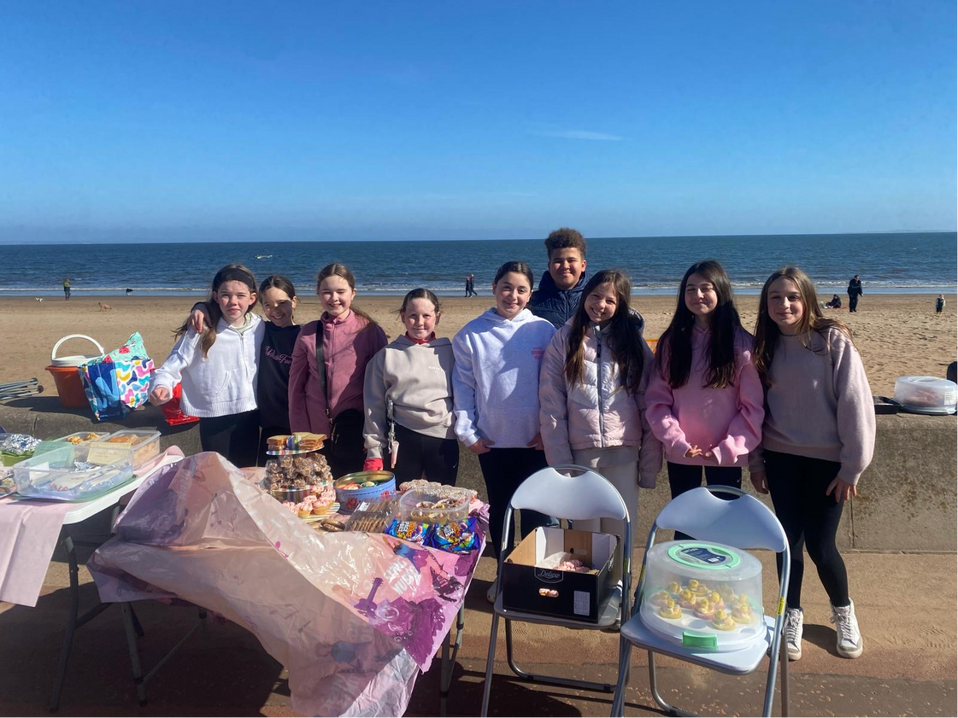
REFRESHING OUR RATIONALE
Challenge:
Current rationale doesn’t reflect our unique community
Plan:
Co-create new rationale with staff, pupils, parents, and partners
Use surveys, workshops, and consultations
Benefit:
• Shared identity, pride, and values alive across the school
Notes:
Challenge – doesn’t fully reflect our context – coastal, urban setting
Plan – gather the voice of the school community in engagement events
Benefit – clear, shared sense of what we stand for – live out the values: respect, ambition, kind, achieve in our classrooms, playgrounds and the wider community ; instil a sense of pride – what doe we stand for as a modern, inclusive Catholic school?

Slide 9
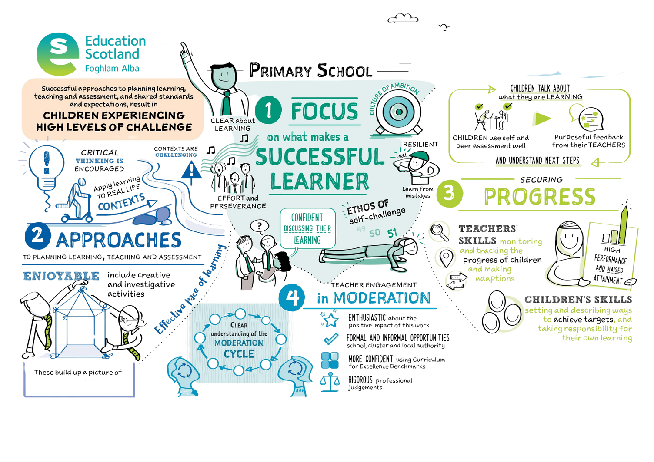

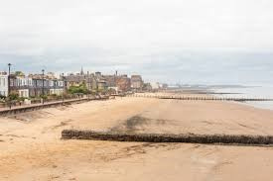


St John’s RC
a St John’s Learner
»
» Read full report
«

Slide 10
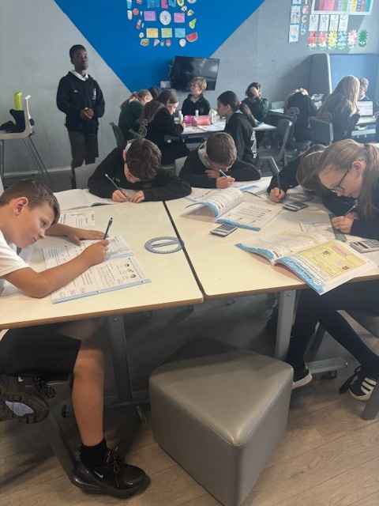
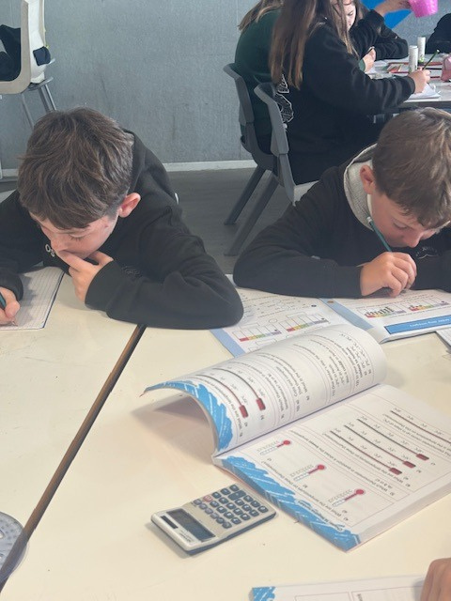
NUMERACY
MATHS

Slide 11
RAISING ATTAINMENT IN NUMERACY
Challenge:
Inconsistent attainment and approaches across classes
Plan:
Common planning framework & regular moderation
Staff training, new assessment tools
Share benchmarks and strategies with families
TARGETS:
• EARLY LEVEL 84% → 90%
• P2 ATTAINMENT +5%
• SECOND LEVEL 84% → 90%
Notes:
Challenge- Attainment in numeracy, while ‘good’ is inconsistent year to year – why is this? Investigate teaching approaches and assessment strategies
Plan - CEC progression pathways –all staff will use these to and become confident in their usage.
Benefits - We want to charter a child’s numeracy journey – clear progression from Early – Second Level; parents supporting learning at home in real life meaningful ways.

Slide 12
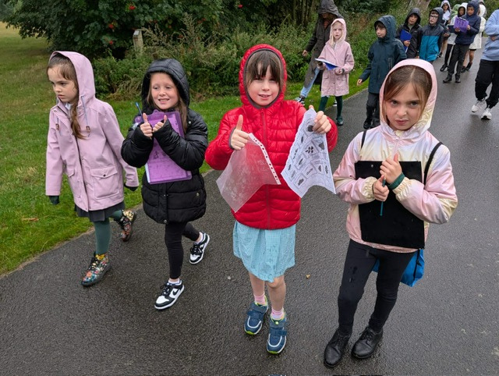
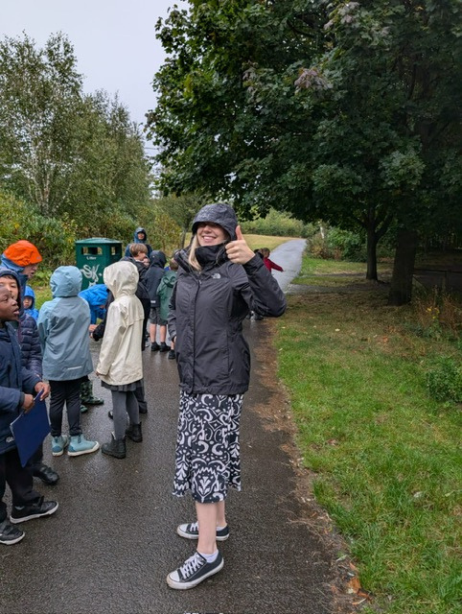
LEARNING FOR SUSTAINABILITY
OUTDOOR LEARNING

Slide 13
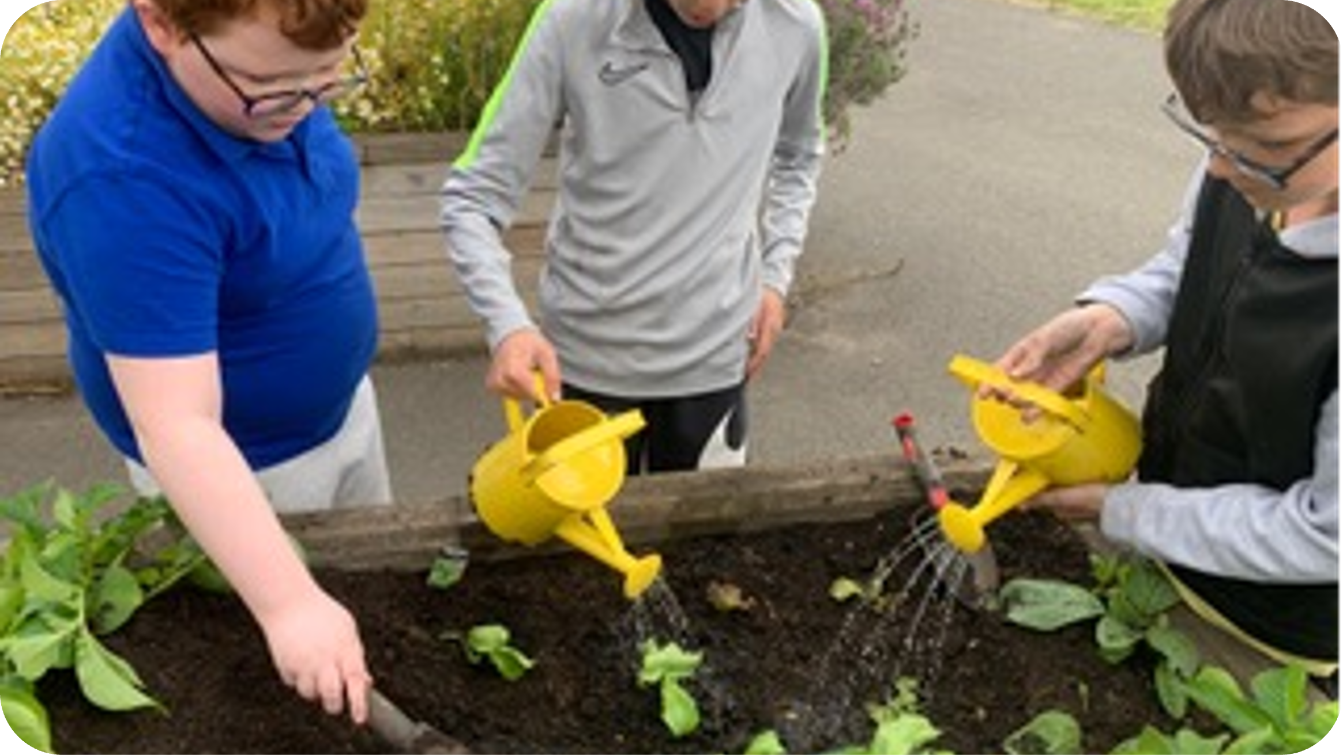
LEARNING FOR SUSTAINABILITY/OUTDOOR LEARNING
Challenge:
Not yet embedded in all classes
Pupils want more outdoor learning opportunities
Plan:
Staff training in outdoor & sustainability education
Weekly outdoor learning, Rights Respecting Schools award
Global Goals & UNCRC integrated in assemblies
BENEFIT:
• EXCITING, HANDS-ON LEARNING
• STRONGER WELLBEING, GLOBAL CITIZENSHIP, LEADERSHIP SKILLS
Notes:
Challenge – LfS & Outdoor Learning incl RRSA not embedded in all classes; staff asked for more training, pupils asking for more opportunities
Plan - All staff – teachers and PSA receiving high quality training in outdoor learning – Mrs Birdsell: LfS Champion; build citizenship, children’s rights and global goals into curriculum. Embed UNCRC/global goals into assemblies – all children should know their rights, create class charters; aim for Silver
Benefit – more exciting, meaningful learning ; clear links between climate action, global citizenship & Catholic values; pupils developing leadership skills, responsibilities and wellbeing through being outdoors.
Families invited to share skills and join classes on the learning journey – offers skills and time.

Slide 14

HOW PARENTS CAN BE INVOLVED
Join consultation workshops on the new rationale
Support numeracy learning at home
Attend outdoor learning and Global Goals events
Share feedback via surveys and conversations
Be active partners in shaping our school community – can you share skills, experiences in the priority areas?

Slide 15
LOOKING AHEAD: SHARED VISION
A school identity that belongs to us all
Consistent, high-quality numeracy and learning experiences
Rich outdoor and global learning opportunities
Children who feel listened to, valued, and proud to be part of our St John’s community.

Slide 16
Q & A

