Slide 1
Standards & Quality Report
Session 2025/26
Growing in Faith, Learning for Life

Slide 2
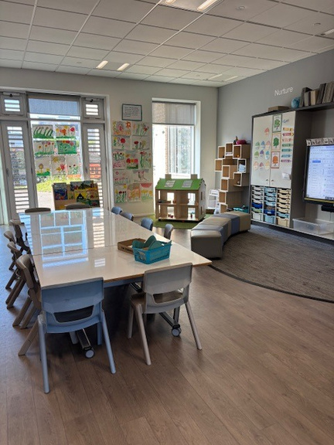
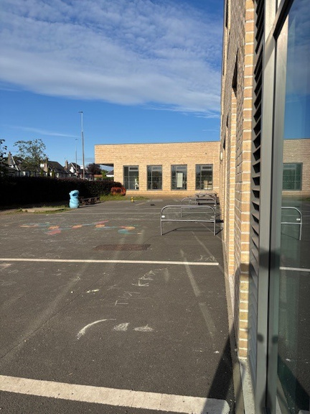

AT THIS SCHOOL WE LOVE TO LEARN

Slide 3

Standards and Quality Report
Summary for Parents and Carers
This is the summary of the areas we have evaluated in Session 25/26.
Quality Indicators are used to evaluate each area:
1.3 Leadership of Change
2.3 Learning, Teaching & Assessment
3.1 Ensuring Wellbeing, Equality & Inclusion
3.2 Raising Attainment & Achievement

Slide 4
1.3 Leadership of Change
What have we done | Next Steps
Begun to embed Children’s rights across the whole school and nursery and prepared to submit our accreditation for RRSA Silver Award Increased opportunities for pupil participation through pupil leadership groups and pupil voice – discussing their learning with SLT Embedded our new values throughout the school | Review of curriculum rationale locally and nationally Work on embedding RRSA Silver Award Increase pupil participation in making decisions about learning, wider achievement and pupil leadership groups

Slide 5
2.3 Learning, Teaching & Assessment
What have we done | Next Steps
Embedded numeracy progression pathways into teaching and learning programmes Ensured each class has an increase in outdoor learning Introduced Supports and Strategies pupil friendly documents for pupils with identified need | Increase challenge and higher order questioning for all pupils Continue to develop outdoor learning Create an excellent lesson and learning & teaching toolkit

Slide 6
3.1 Ensuring Wellbeing, Equality and Inclusion
What have we done | Next Steps
Continue to build a nurturing, rights-respecting school where children are kind, respectful, ambitious and achieving Celebrated our diverse school community through inclusive events Reduce barriers for Learning through targeted interventions and approaches | Strengthen children’s understanding of anti-racist education Increase focus on Wellbeing with children able to identify how they feel Support staff with a range of approaches to help with children’s emotional regulation

Slide 7
3.2 Raising Attainment & Achievement
What have we done | Next Steps
Most learners are achieving expected Curriculum for Excellence levels in literacy and numeracy Wider achievements are celebrated and tracked Staff are confident in using city wide tracking system to record pupil progress and attainment. | Continue to improve writing through consistency of teaching and learning approaches Develop whole grammar progression in collaboration with learning community

Slide 8
LOOKING AHEAD: SHARED VISION
  A school identity that belongs to us all
  Consistent, high-quality numeracy and learning experiences
  Rich outdoor and global learning opportunities
  Children who feel listened to, valued, and proud to be part of our St John’s community.

